Slide 1

Nomios Security Cup
29-31 maja 2025
Hotel Mazurski Raj

Slide 2

Zero Trust + AI
Securing, Simplifying and Transforming Businesses
Pawel Nowakowski
Wojciech Zajchowski
Maj 225

Slide 3

Zscaler’s Mission:
To Secure, Simplify and Transform Businesses
Secure
35x
Fewer infected machines
Reduce Business Risk
Simplify
70%
Infrastructure Cost reduction
Eliminate Cost and Complexity
Transform
1
Day to connect a new warehouse
Increase Business Agility
STRONG PUBLIC COMPANY
MARKET LEADER
DELIGHTED CUSTOMERS
Nasdaq-100
Index Member (ZS)
45+ Million
Users Secured
70+ NPS SaaS Avg: 30
Net Promoter Score
$2B+ ARR
$500M Net Annualized Positive Cash Flow
13 Years
Gartner MQ Leader in SSE & SWG
13+ Years
Cloud operational excellence
40% of the Fortune 500
30% of the Forbes Global 2000
50% International Business
Capital Goods
Household &
Personal Products
Banking
(outside of China)
Aerospace
& Defense
Health Care Equipment & Services
Clothing, Shoes & Sports Equipment
Drugs &
Biotechnology
Utilities
Transportation
8_{/10}
9_{/10}
8_{/10}
6_{/10}
7_{/10}
8_{/10}
6_{/10}
6_{/10}
6_{/10}
*Forbes Global 2000 list for 2023

Slide 4


Zscaler Vision and Founding
New Business World
Leverage disruptive technologies to become more Agile and Competitive
Mobility
Cloud
IoT/OT
AI/ML
But traditional network and security architectures become a liability.
Traditional Network and Firewall Architecture
Zscaler Vision: Reimagined a New Architecture for Networking and Security
Cloud
Internet
SaaS
Cloud
Cloud
Internet
SaaS
DC /Colo
Cloud Services
A new cyber architecture is needed
Remote workforce
DC / Colo
B2B Partners
Zero Trust Exchange
Campus, Branch, Factory
Workforce
Campus, Branch, Factory
B2B Partners
A trusted private network connects everything
Secure the network with perimeter firewalls
An exchange / a switchboard to connect user, devices, and workloads using business policies over any network
Lower TCO, Superior Security, Great Experience
Worked well in the old world, but is now a liability
Expensive, Security Risk, Poor Experience

Slide 5



Transportation Services
The Royal Caribbean Group is a global cruise holding company incorporated in Liberia and based in Miami, Florida, United States. Comprised of three brands, the Royal Caribbean International, Celebrity Cruises, and Silversea Cruises, its 85,000 employees are spread over primarily 52 ships.
Miami, FL, USA
85,000+ employees on 52 ships
Improves security posture by eliminating hub-and-spoke networks
Delivers seamless experiences wherever employees work from
“Zscaler Zero Trust Exchange has allowed us to truly be able to work from anywhere. Anywhere being an office, one of our cruise ships, a hotel, an airplane, a Starbucks.”
Become a more secure enterprise, decrease operational costs, and provide a better user experience
Zscaler Zero Trust Exchange™
Zscaler Internet Access™
Zscaler Private Access™
Zscaler Digital Experience™
John Maya, VP of Operational Excellence, Royal Caribbean Group
Improves security posture by reducing reliance on hub-and-spoke networks
Delivers seamless experiences to whichever location(s) employees work from
Bolsters cyber defenses and threat detection with zero trust security
Lowers operational costs by simplifying data centers and lessening the need for appliances
View Success Story

Slide 6
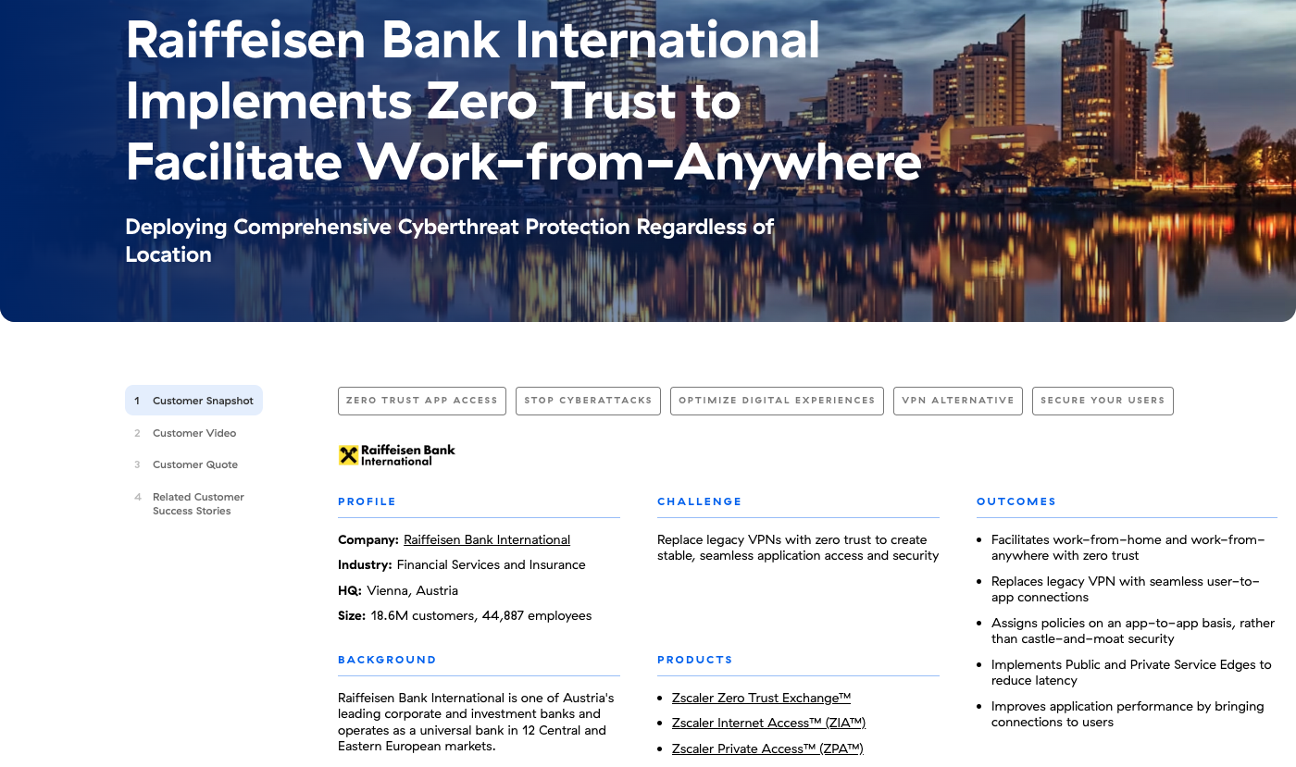
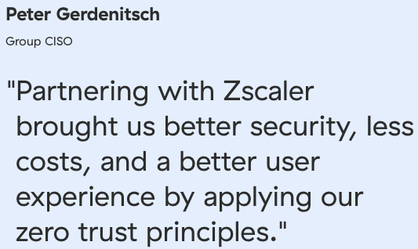

Slide 7


Energy, Oil, Gas & Mining
MOL Group has more than 85 years of experience with hydrocarbons and 30 years with CO2 injection. The company operates three refineries and two petrochemical plants under integrated supply chain management in Hungary, Slovakia, and Croatia. It owns a network of approximately 2,000 service stations across nine countries in Central and Southeast Europe.
Budapest, Hungary
25,000 employees in 30 countries
Reduces team size managing web content filtering by 50%
Yields significant operational cost savings
“No other vendor could even come close to the Zscaler Zero Trust Exchange, which provides our users with a consistent experience through a unified set of integrated, centrally managed solutions.”
Evolve a consolidated zero trust architecture to accommodate a mobile workforce, rapid expansion, and new lines of business.
Zscaler Zero Trust Exchange™
Zscaler Internet Access™
Zscaler Private Access™
Zscaler Cloud Firewall
Zscaler Digital Experience
Posture Control™
Tamás Kapócs, Head of Cybersecurity Strategy & Architecture, MOL Group
Provides an enhanced user experience
Reduces the size of the proxy operations team managing web content filtering solutions by 50%
Yields significant operational cost savings
Decreases the number of help desk tickets substantially
Increases overall cybersecurity engagement
View Success Story

Slide 8

Nomios
Case study

Slide 9


Zscaler Zero Trust Platform
External Apps
Internal Apps
ZIA for Users and Workloads
Secure Internet/SaaS Access
SaaS
Sanctioned
Internet
Public Cloud
Data Center
ZPA for Users and Workloads
Secure Private App Access
Cyber Threat Protection
AI-driven inline content inspection (SSL/TLS)
Remote App Access without VPN
Workforce, third-parties, B2B customers
Block the bad, protect the good
Connect to apps, not the network
Data Protection
Inline DLP and CASB, API CASB
Direct App Access (no backhaul)
Hybrid and multi-cloud environments
Zscaler Internet
Access (ZIA)
Zscaler Private
Access (ZPA)
Local Internet Breakouts
Microsoft 365, SD-WAN
Workload to Workload Communication
Zero trust access among apps/workloads
ZERO TRUST EXCHANGE
IDP
Ensure a great user experience
Zscaler Digital Experience (ZDX)
Any User, Any Device, Any App, Any Location

Slide 10
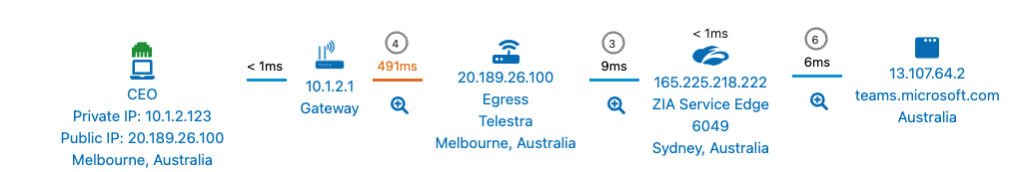



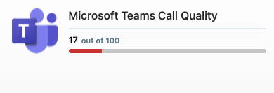
Proactively identify and resolve performance issues (ZDX)
  Visibility from Endpoint to App
  Continuous performance analysis form endpoint to app
Full view of every step of the traffic path
Apps
Performance, availability, and uptime
Data Center
Internet
SaaS
IaaS/PaaS
Network
Hop-by-hop performance
Device Health
CPU | Memory | Disk I/O
N/W I/O | Bandwidth | Processes
High latency between Hotel gateway and ISP
  Digital Experience Score
Quickly identify Zoom and Teams performance issues
Meeting Session
Audio : Latency | Jitter | Loss | MOS
Video : Latency | Jitter | Loss
Sharing : Latency | Jitter | Loss
Endpoint
Device and Connectivity Health
SPECIFIC USER
All users / All locations
10

Slide 11
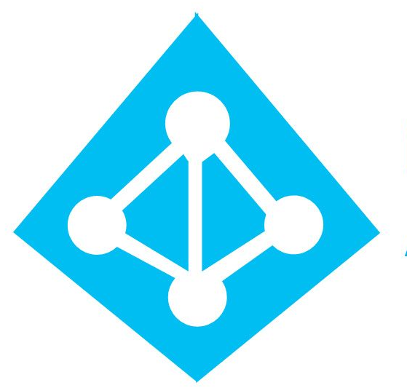


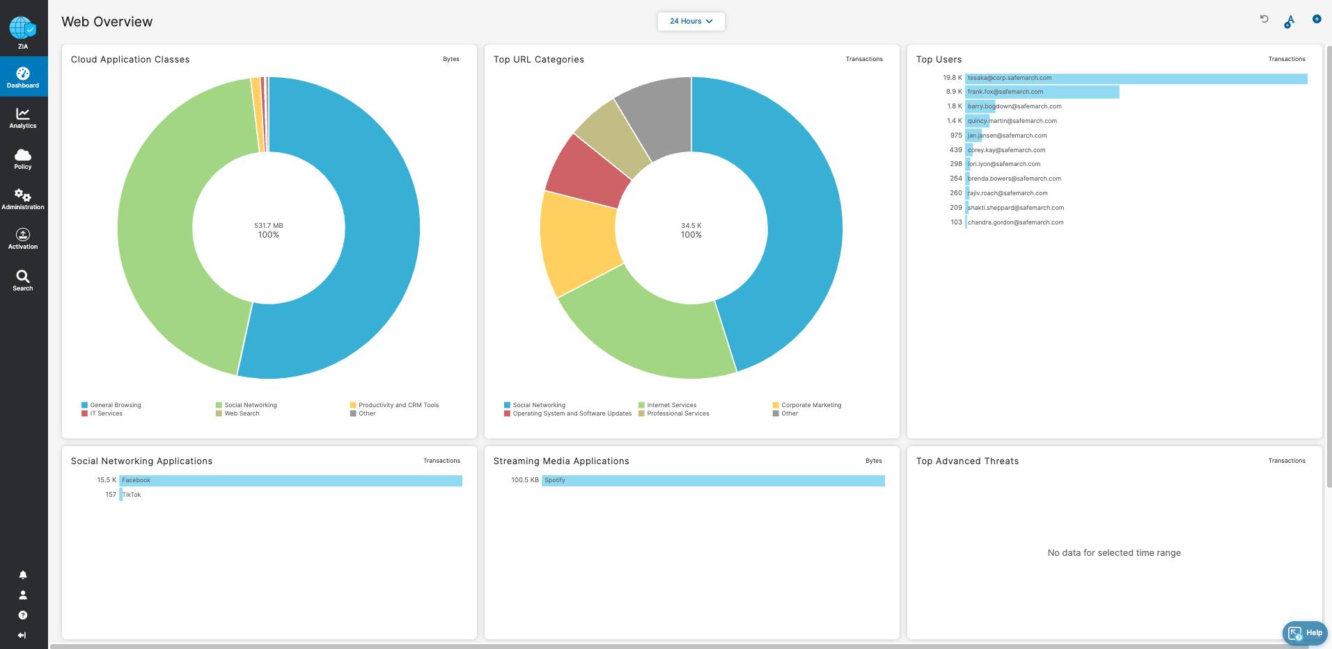
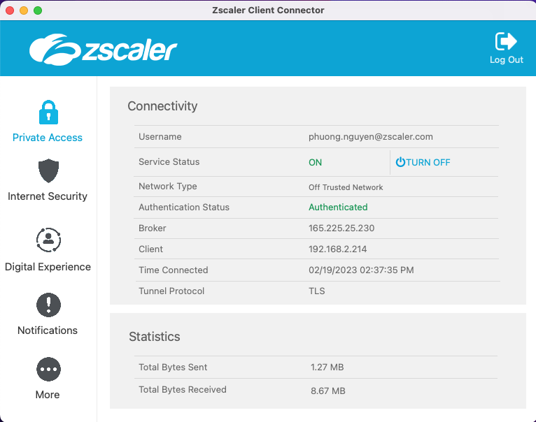
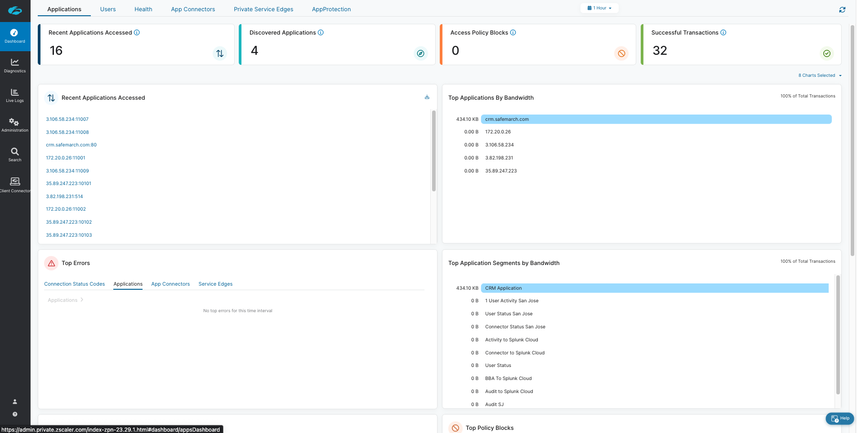
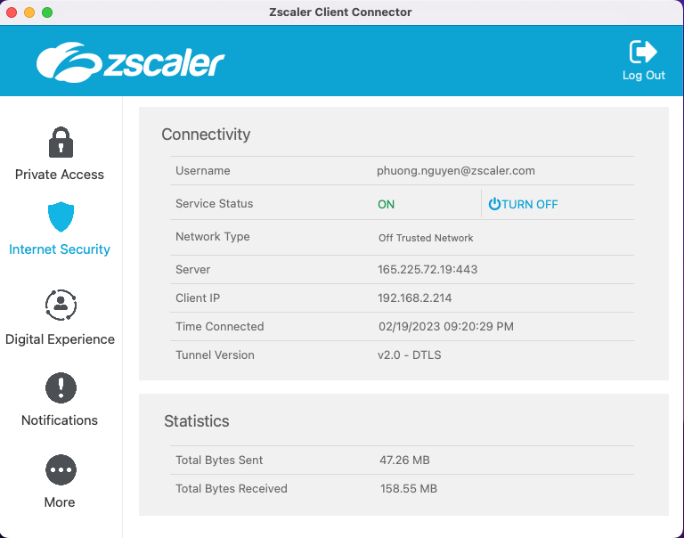
Deployment steps
1
Configure firewall whitelisting for connectivity to Zscaler
Set up authentication with Identity Provider (IDP)
2
Deploy Zscaler Client Connector (ZCC) for test users
Enable security policies in Zscaler Internet Access (ZIA) and test
Enable digital monitoring in Zscaler Digital Experience (ZDX) and test
Enable access to apps in Zscaler Private Access (ZPA) and test
3
Review and summary in collaboration
Planning on steps after testing in collaboration

Slide 12
Dziękuję za uwagę!

