Slide 1

Nomios Security Cup
29-31 maja 2025
Hotel Mazurski Raj

Slide 2
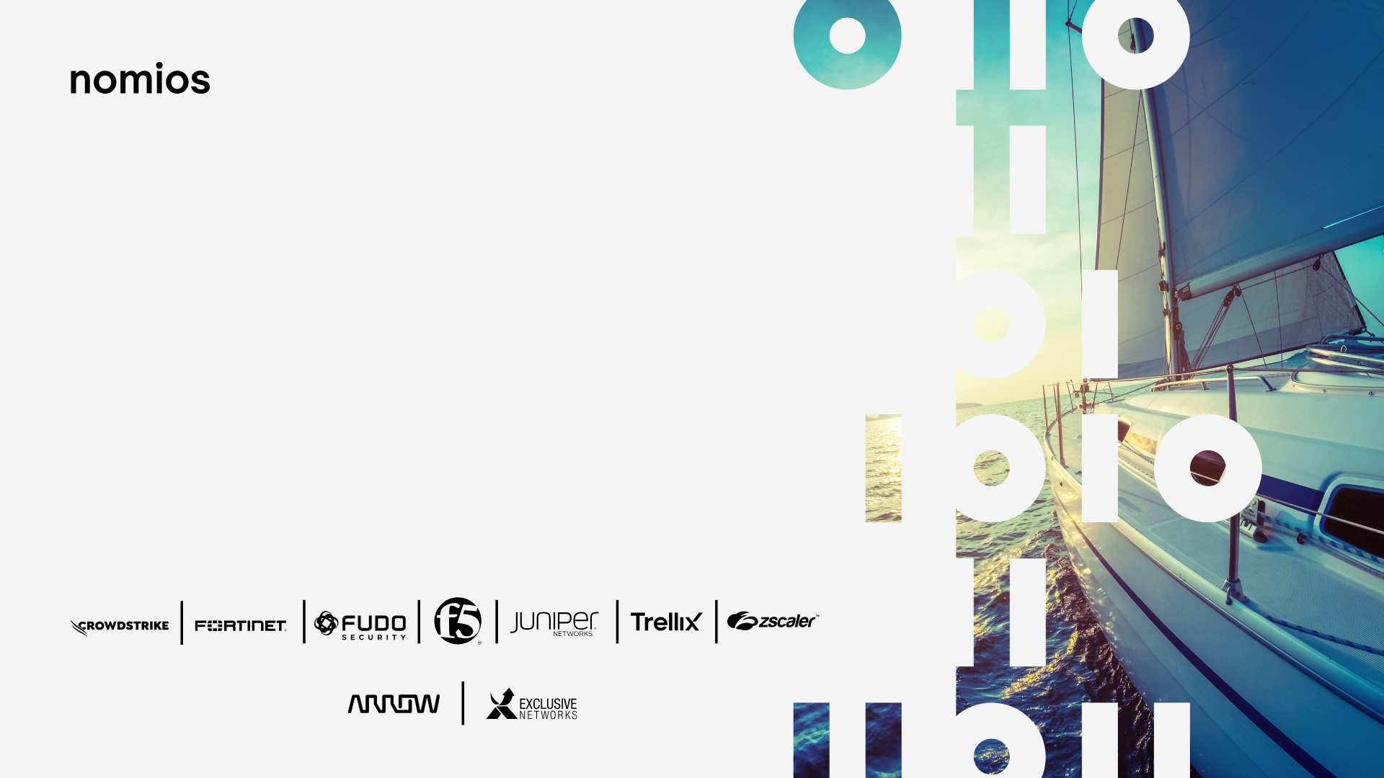
Pełna Moc Naprzód z Falcon Platform
Od EDR po zintegrowane SIEM i CTI

Slide 3
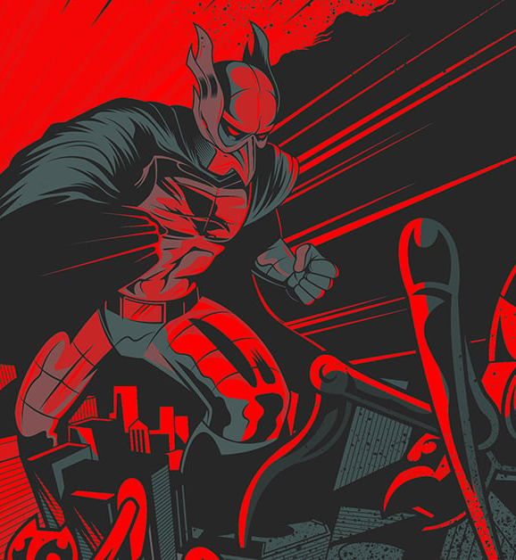

Gabriel Kujawski
<gkujawski@crowdstrike.com>
+48698257556
Senior SE @ CrowdStrike Poland

Slide 5
2018
MALWARE
STOPPING
MALWARE
IS NOT
ENOUGH
61%
HIGH
MALWARE
LOW
THREAT
SOPHISTICATION
Harder to Prevent
& Detect
LOW
HIGH

Slide 6





2018
MALWARE
MALWARE-FREE
61%
YOU NEED COMPLETE
BREACH
PREVENTION
39%
HIGH
MALWARE
LOW
THREAT
SOPHISTICATION
Harder to Prevent
& Detect
NON-MALWARE
ATTACKS
LOW
TERRORISTS
HACKTIVISTS/
VIGILANTES
CYBER-
CRIMINALS
Organized
Criminal Gangs
NATION-
STATES
HIGH

Slide 7
2019
MALWARE
MALWARE-FREE
60%
YOU NEED COMPLETE
BREACH
PREVENTION
40%
HIGH
MALWARE
LOW
THREAT
SOPHISTICATION
Harder to Prevent
& Detect
NON-MALWARE
ATTACKS
LOW
TERRORISTS
HACKTIVISTS/
VIGILANTES
CYBER-
CRIMINALS
Organized
Criminal Gangs
NATION-
STATES
HIGH

Slide 8
2020
MALWARE
MALWARE-FREE
49%
YOU NEED COMPLETE
BREACH
PREVENTION
51%
HIGH
MALWARE
LOW
THREAT
SOPHISTICATION
Harder to Prevent
& Detect
NON-MALWARE
ATTACKS
LOW
TERRORISTS
HACKTIVISTS/
VIGILANTES
CYBER-
CRIMINALS
Organized
Criminal Gangs
NATION-
STATES
HIGH

Slide 9
2021
MALWARE
MALWARE-FREE
38%
YOU NEED COMPLETE
BREACH
PREVENTION
62%
HIGH
MALWARE
LOW
THREAT
SOPHISTICATION
Harder to Prevent
& Detect
NON-MALWARE
ATTACKS
LOW
TERRORISTS
HACKTIVISTS/
VIGILANTES
CYBER-
CRIMINALS
Organized
Criminal Gangs
NATION-
STATES
HIGH

Slide 10
2022
MALWARE
MALWARE-FREE
29%
YOU NEED COMPLETE
BREACH
PREVENTION
71%
HIGH
MALWARE
LOW
THREAT
SOPHISTICATION
Harder to Prevent
& Detect
NON-MALWARE
ATTACKS
LOW
TERRORISTS
HACKTIVISTS/
VIGILANTES
CYBER-
CRIMINALS
Organized
Criminal Gangs
NATION-
STATES
HIGH

Slide 11
2023
MALWARE
MALWARE-FREE
25%
YOU NEED COMPLETE
BREACH
PREVENTION
75%
HIGH
MALWARE
LOW
THREAT
SOPHISTICATION
Harder to Prevent
& Detect
NON-MALWARE
ATTACKS
LOW
TERRORISTS
HACKTIVISTS/
VIGILANTES
CYBER-
CRIMINALS
Organized
Criminal Gangs
NATION-
STATES
HIGH

Slide 12
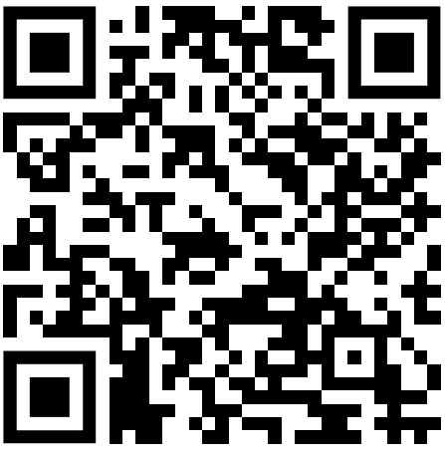
2024
MALWARE
MALWARE-FREE
21%
YOU NEED COMPLETE
BREACH
PREVENTION
79%
HIGH
MALWARE
LOW
THREAT
SOPHISTICATION
Harder to Prevent
& Detect
NON-MALWARE
ATTACKS
LOW
TERRORISTS
HACKTIVISTS/
VIGILANTES
CYBER-
CRIMINALS
Organized
Criminal Gangs
NATION-
STATES
HIGH

Slide 13

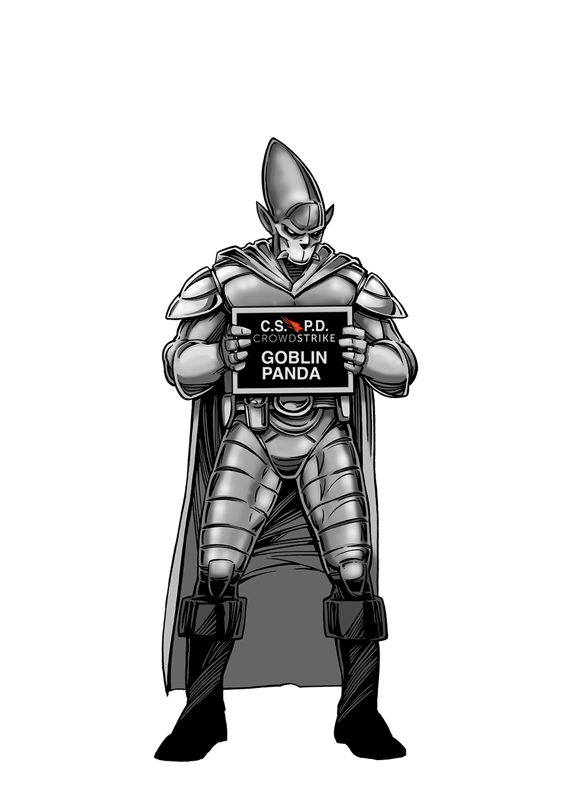
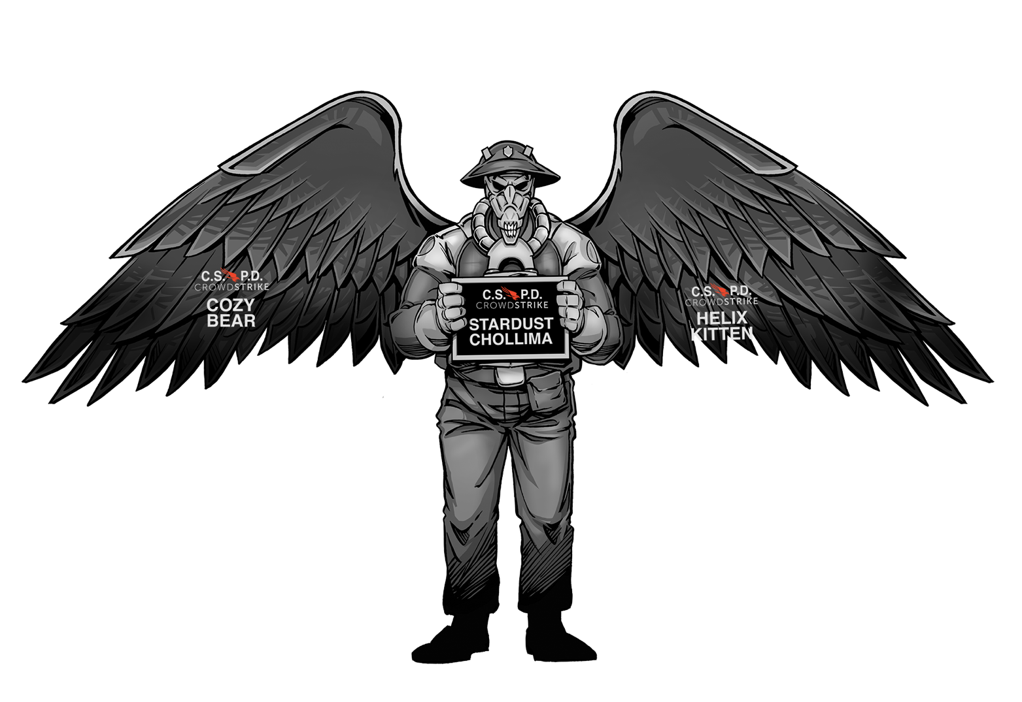
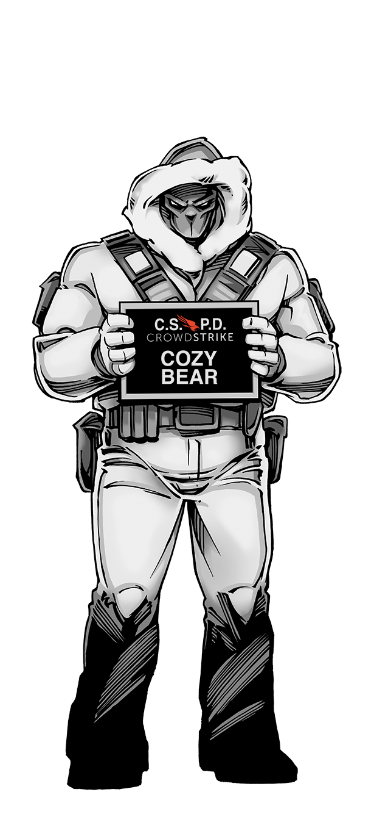
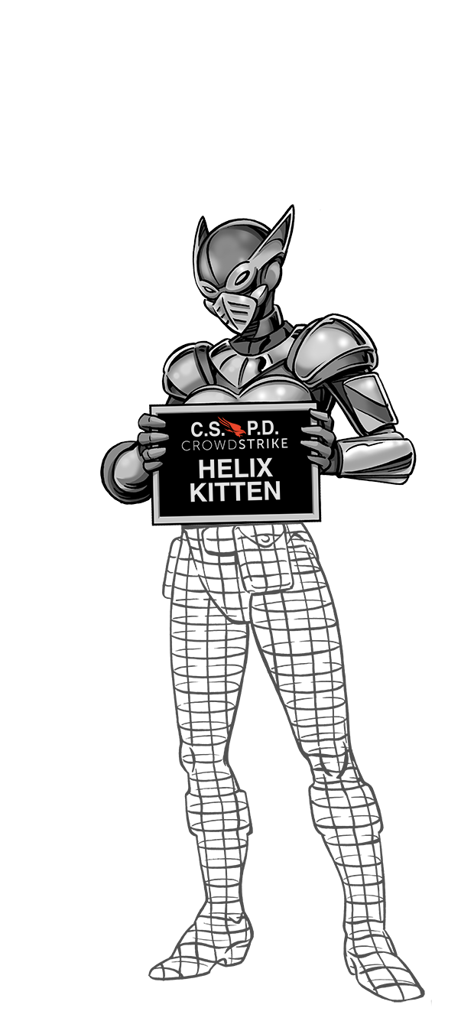
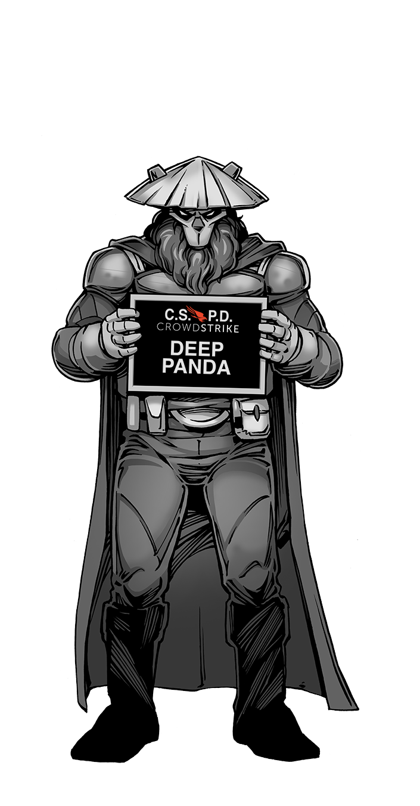
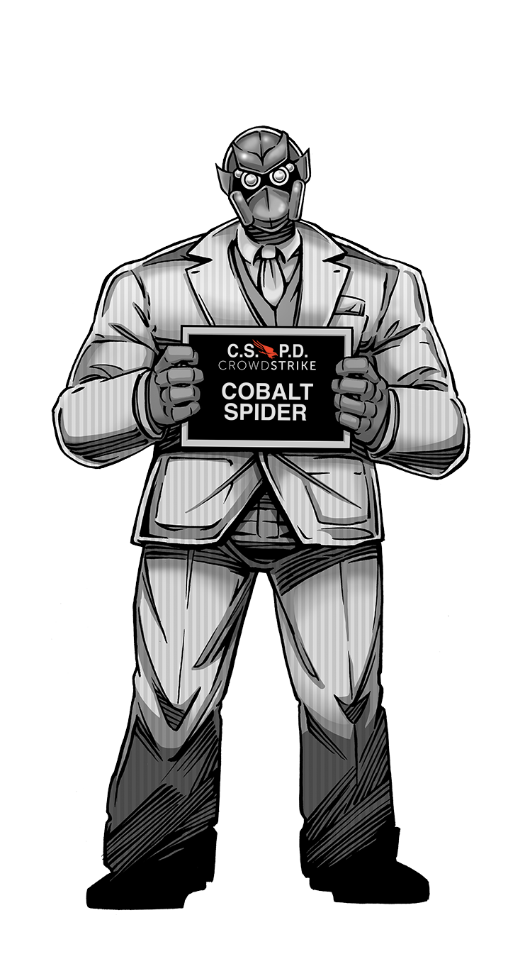
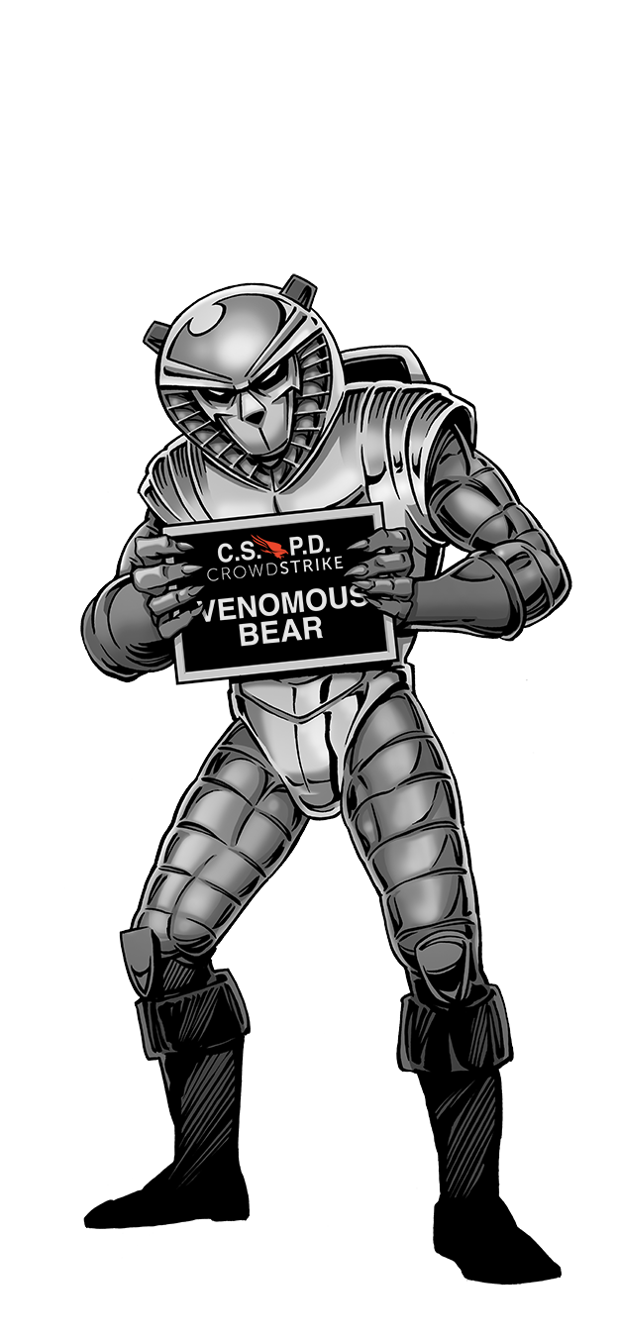

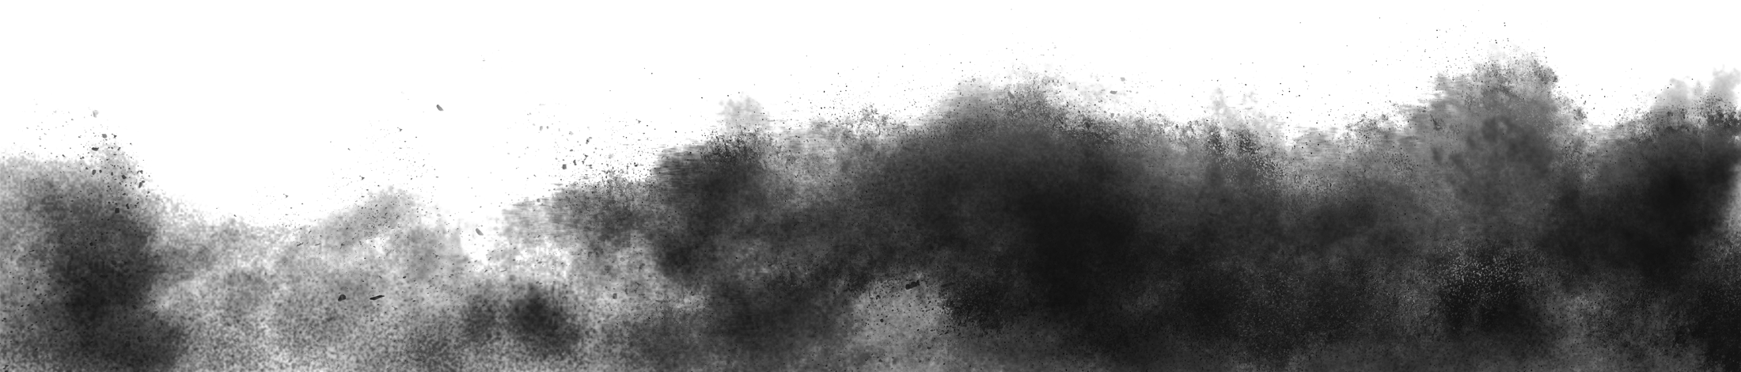
260+
Adversaries Tracked

Slide 14
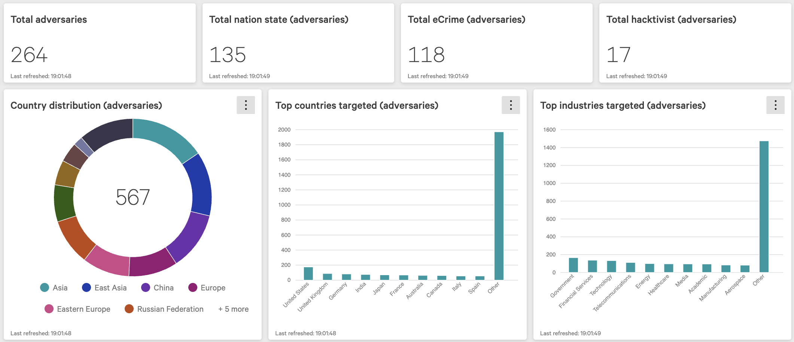

Slide 15
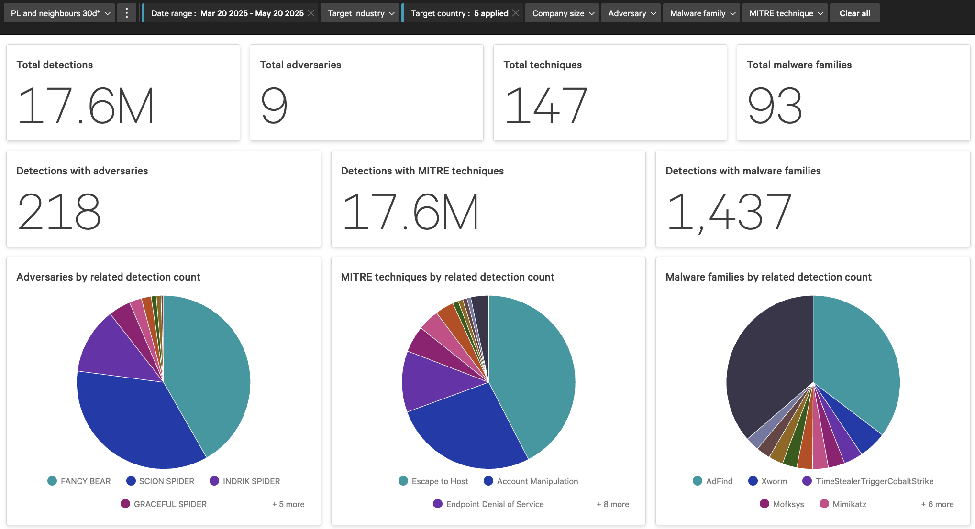

Slide 16

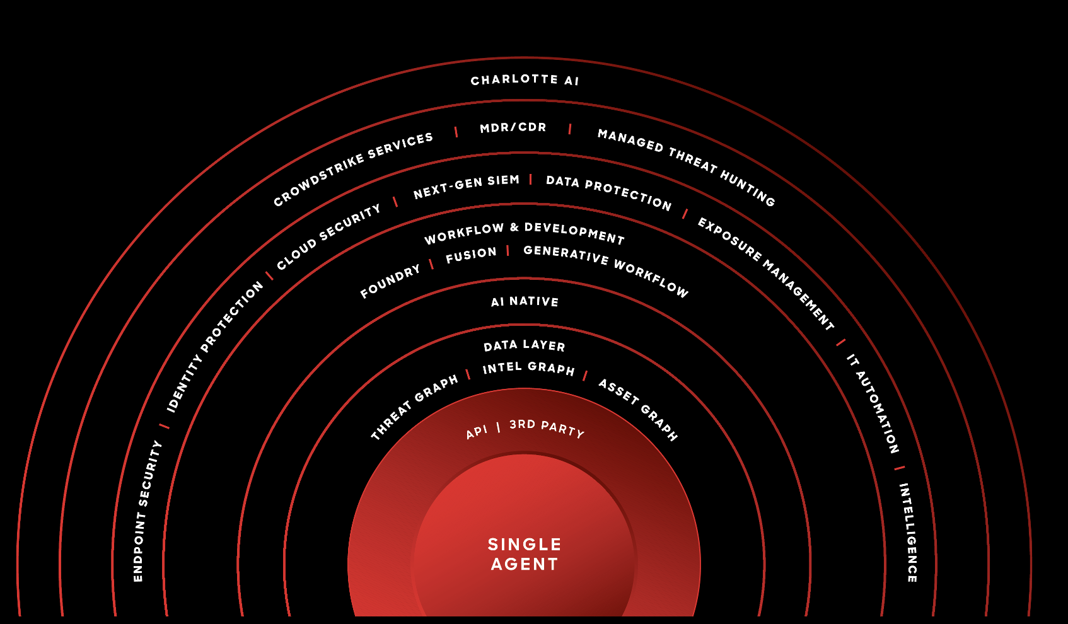

Slide 17
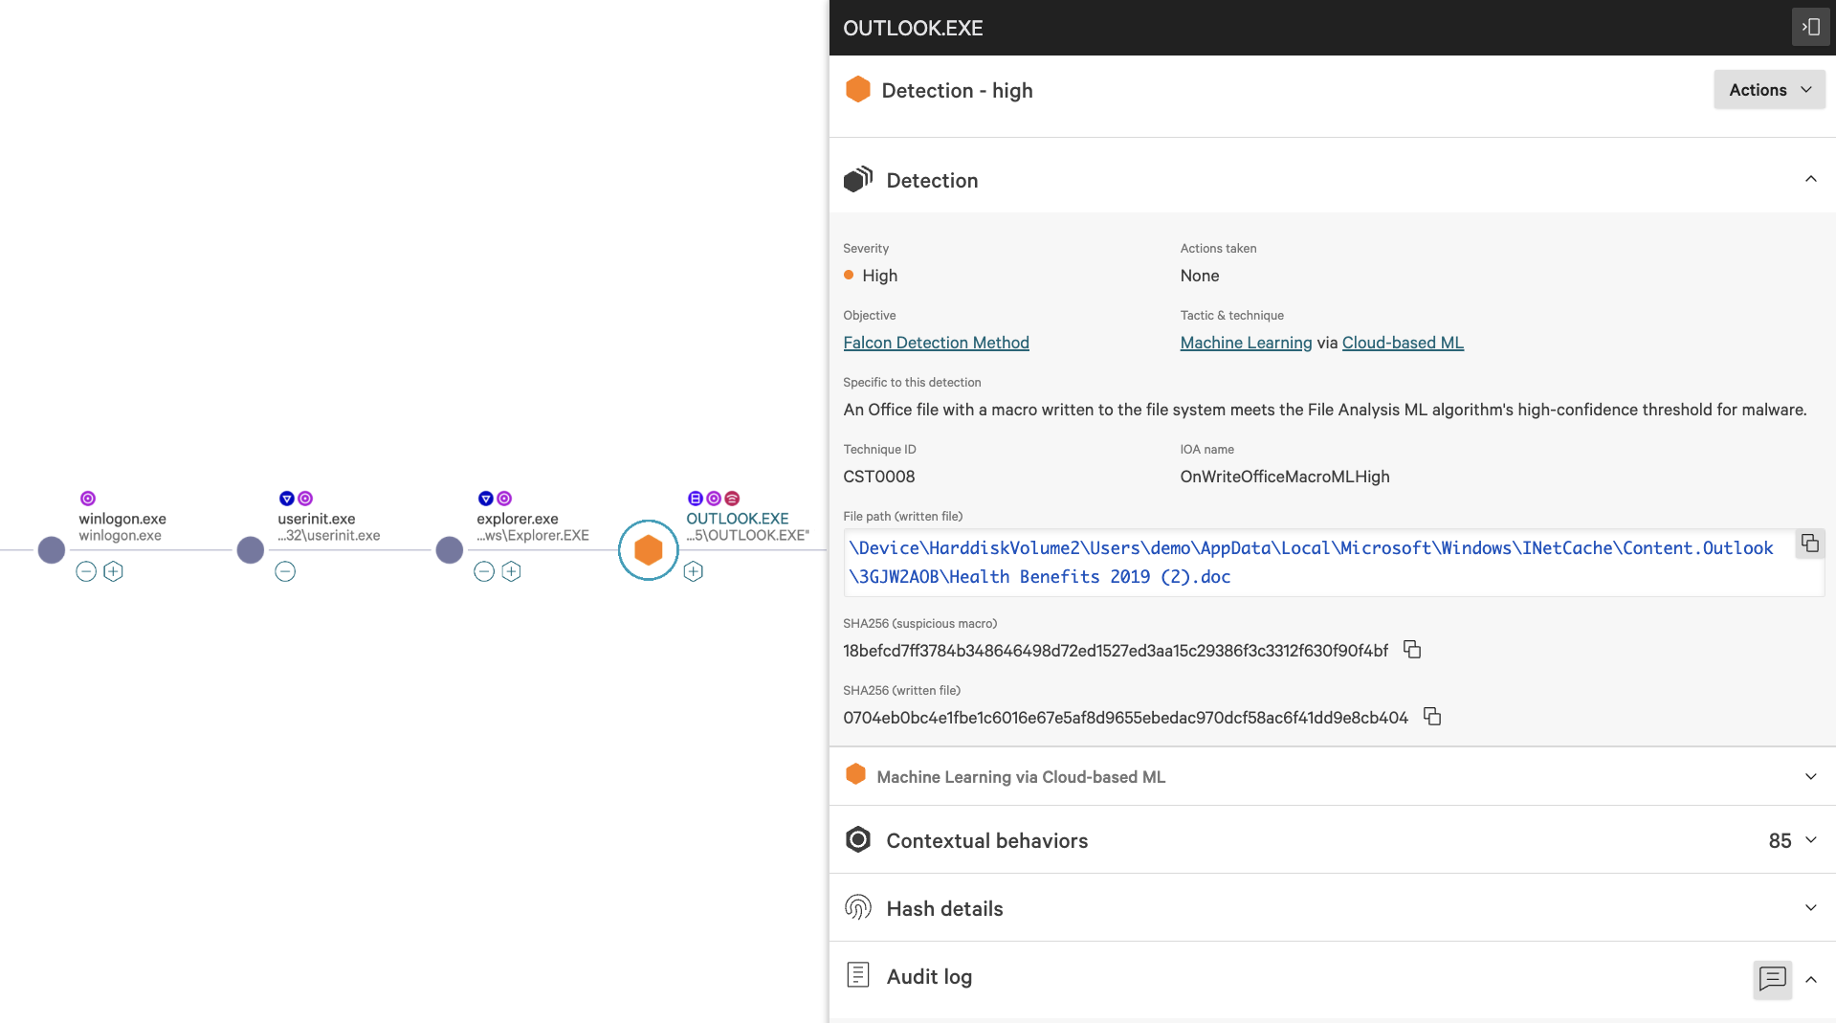

Slide 18
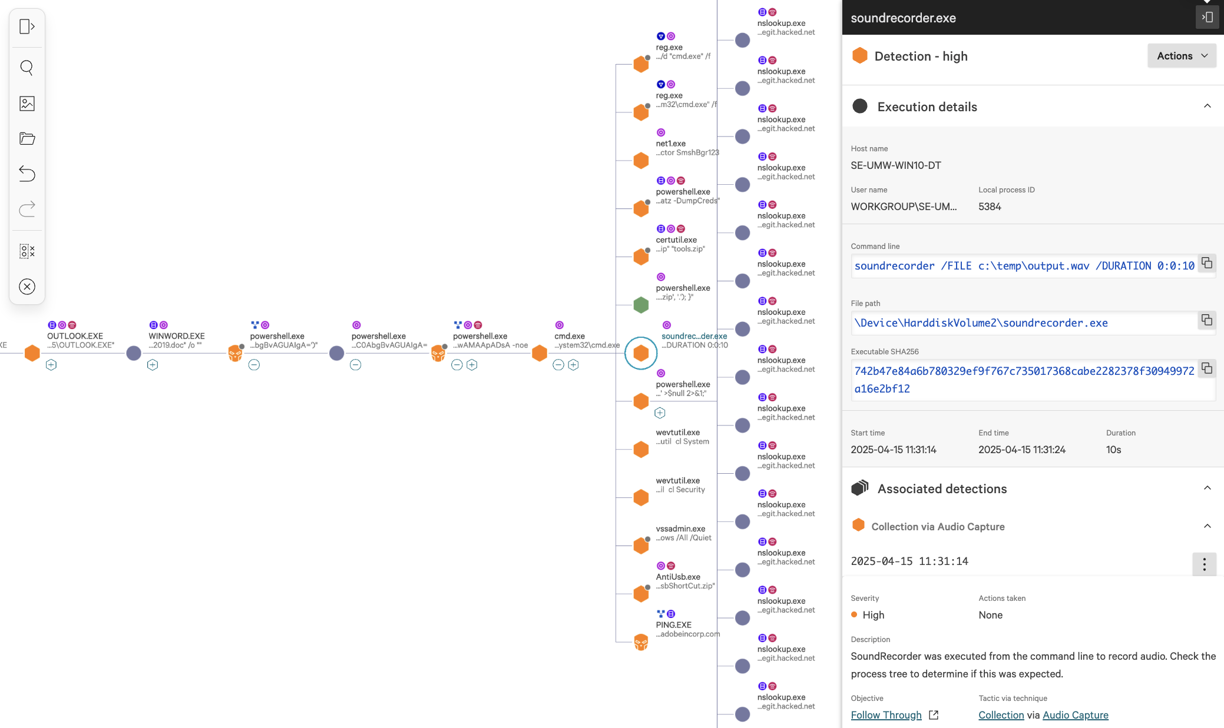

Slide 19
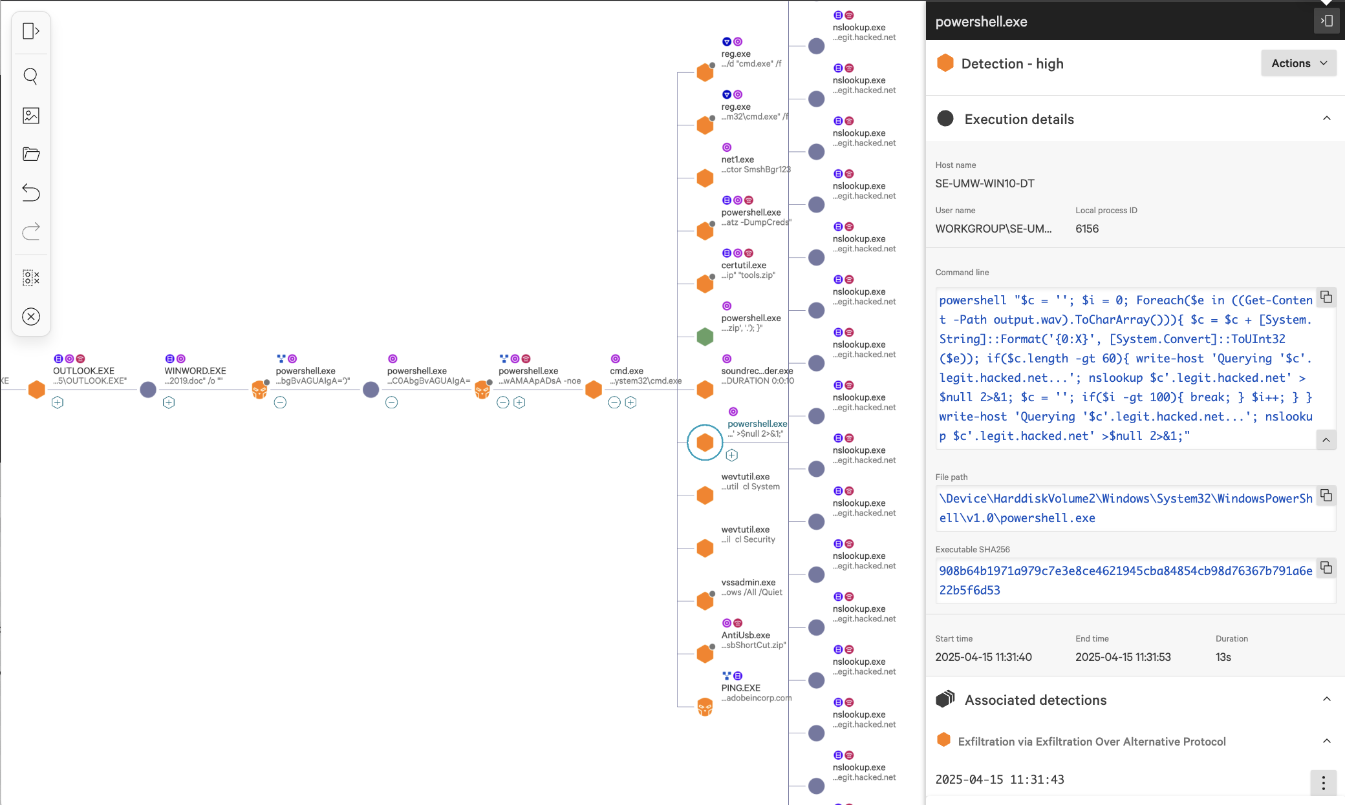

Slide 20
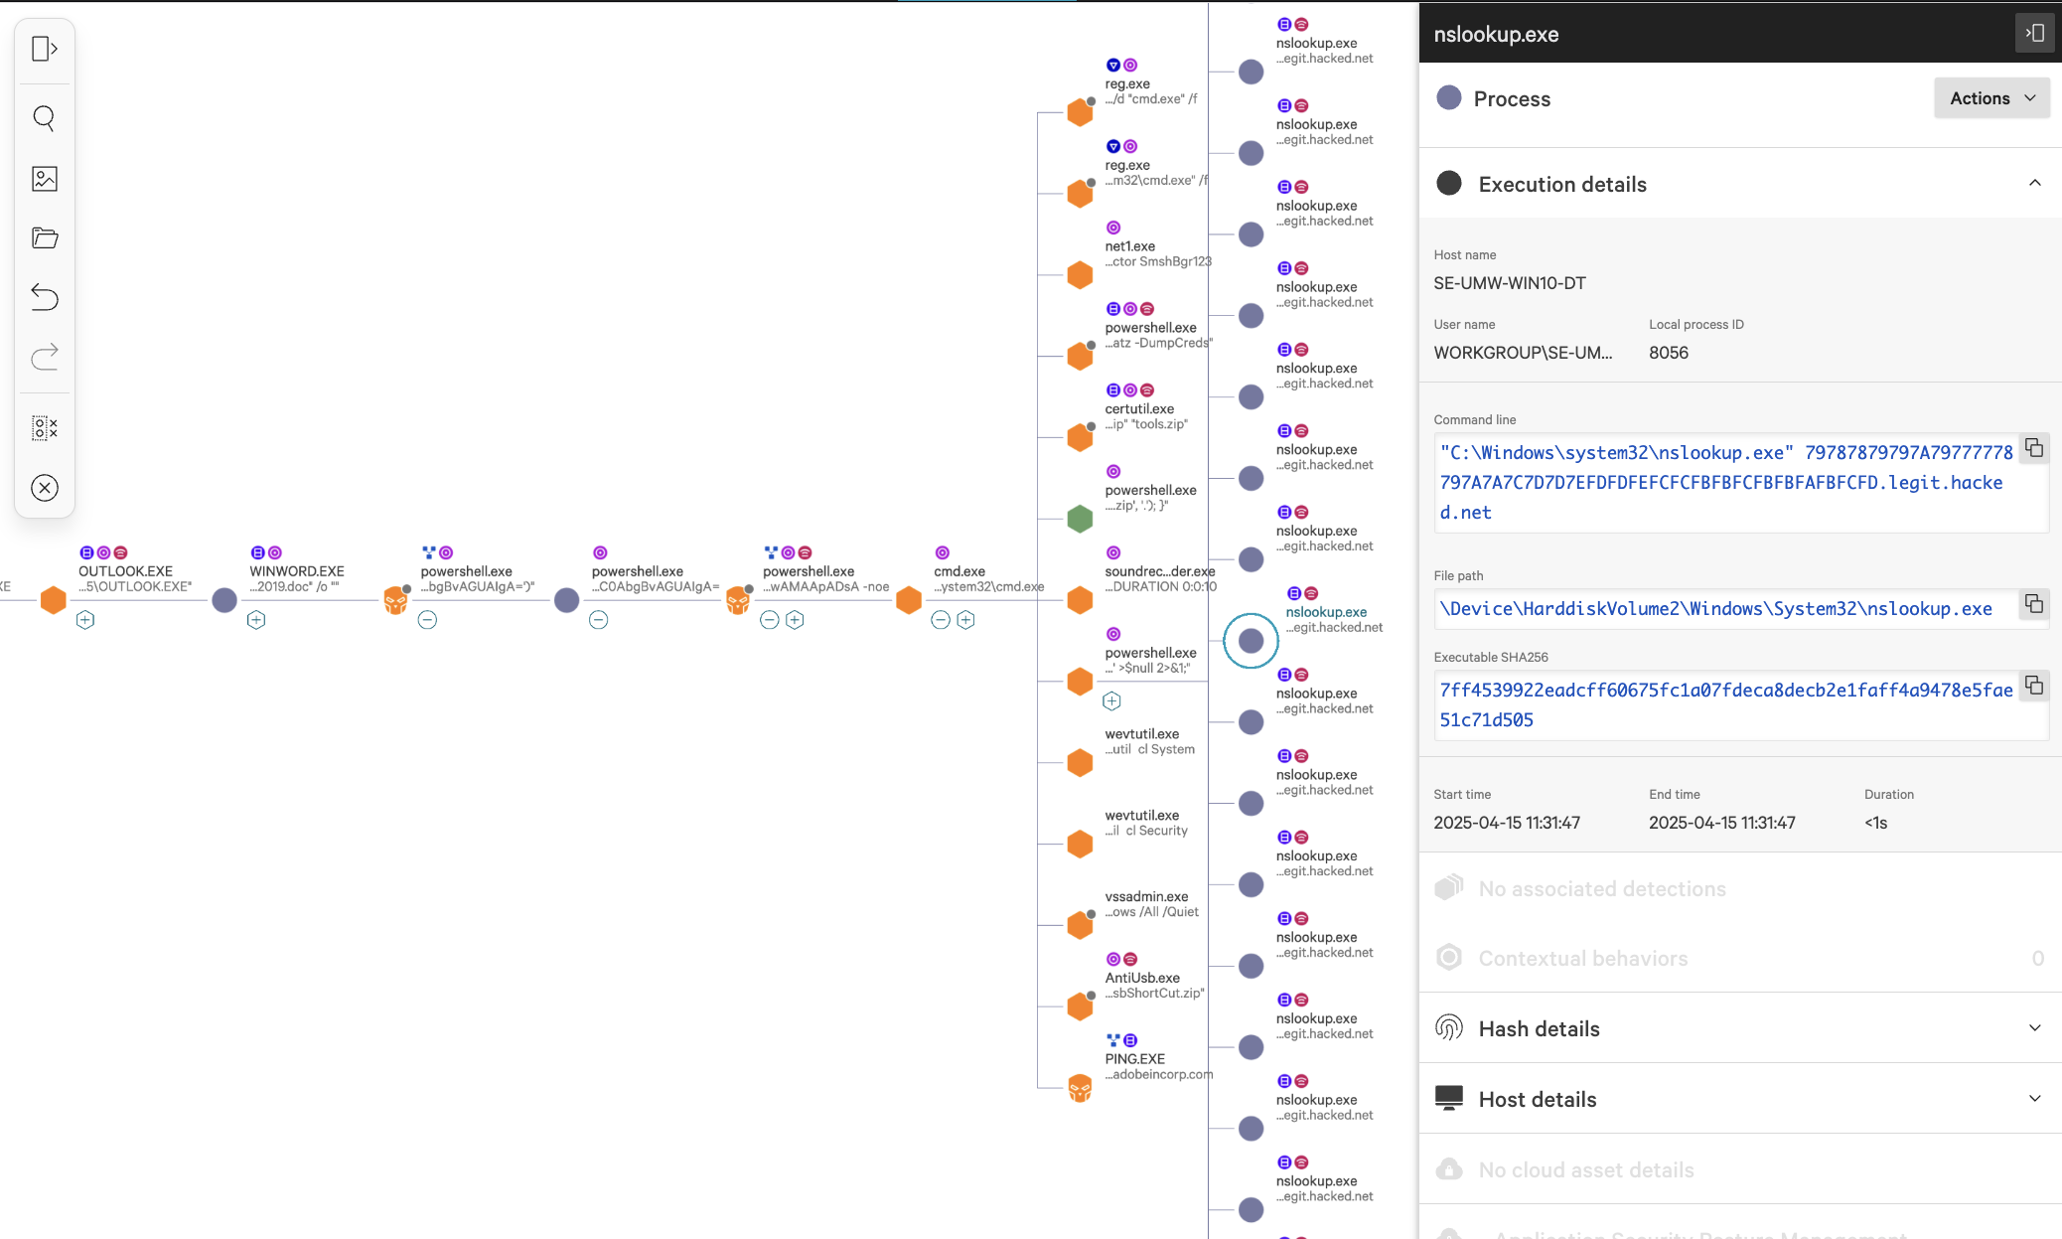

Slide 21
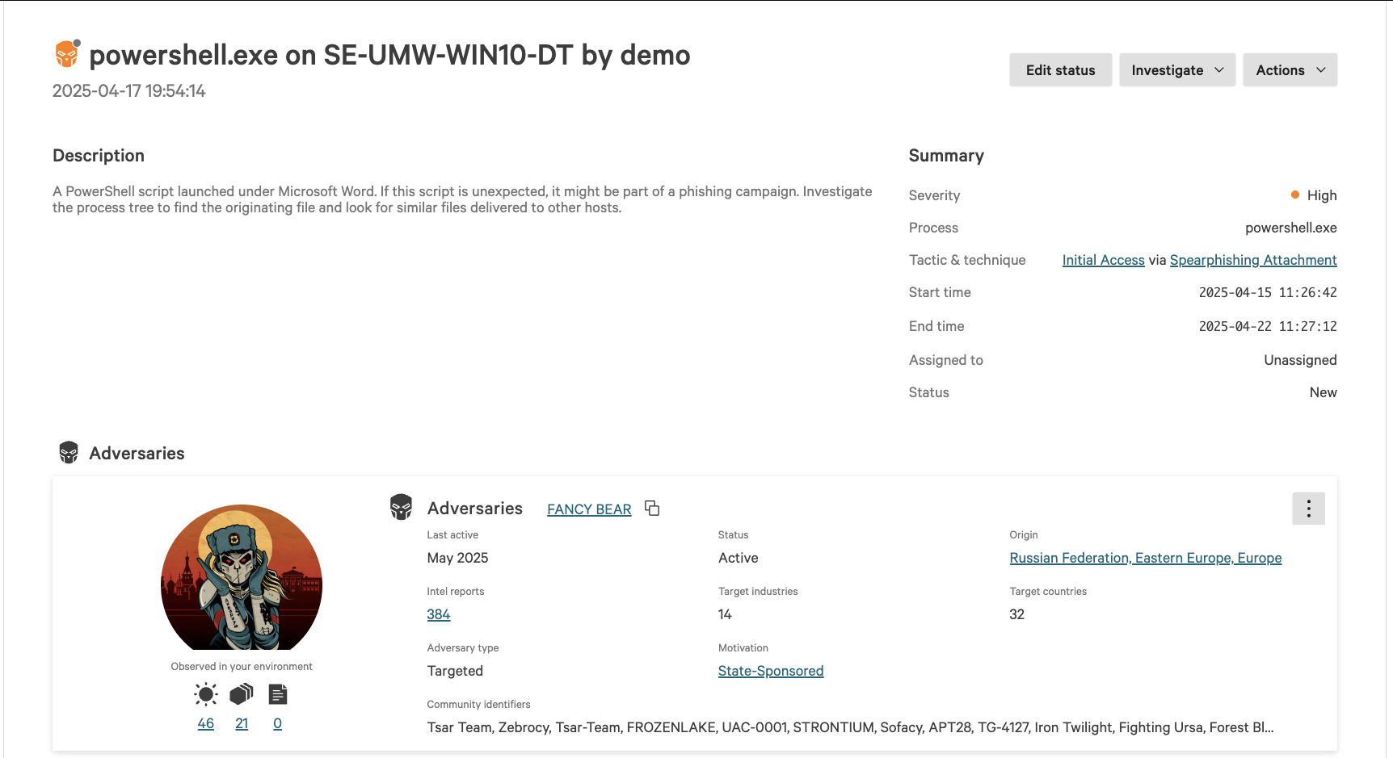

Slide 22
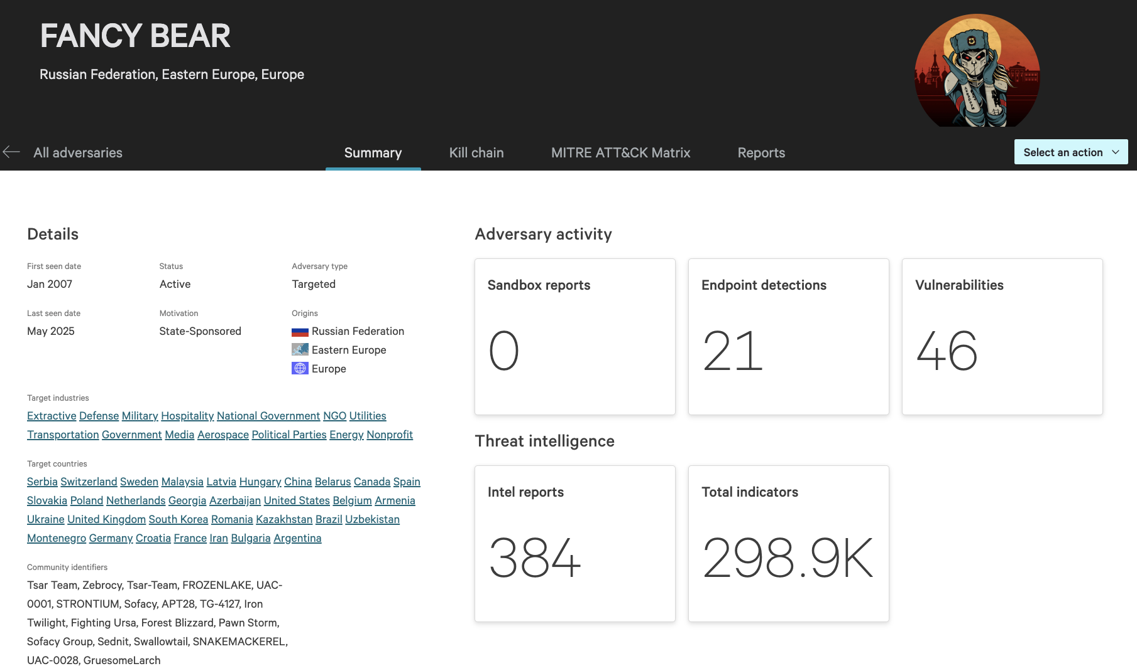

Slide 23
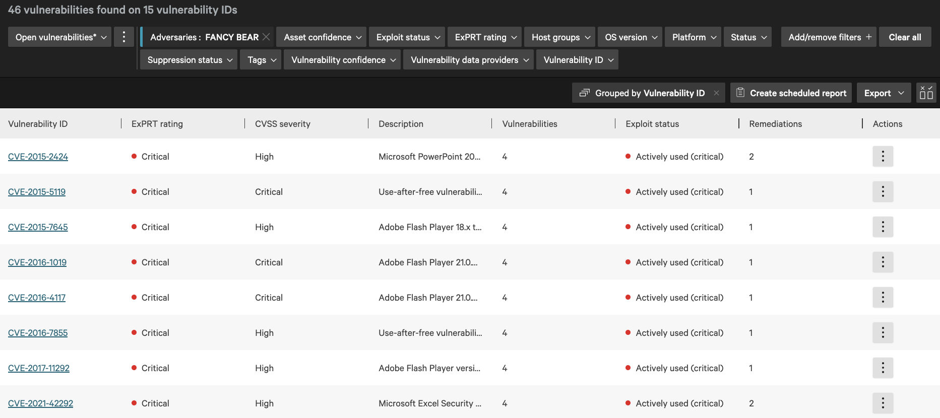
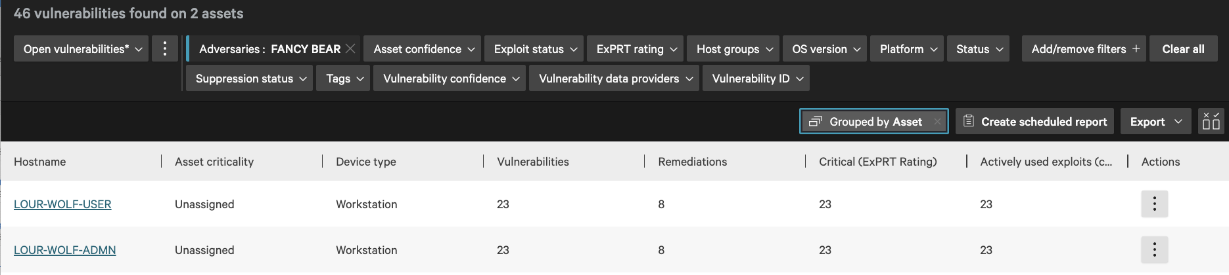

Slide 24
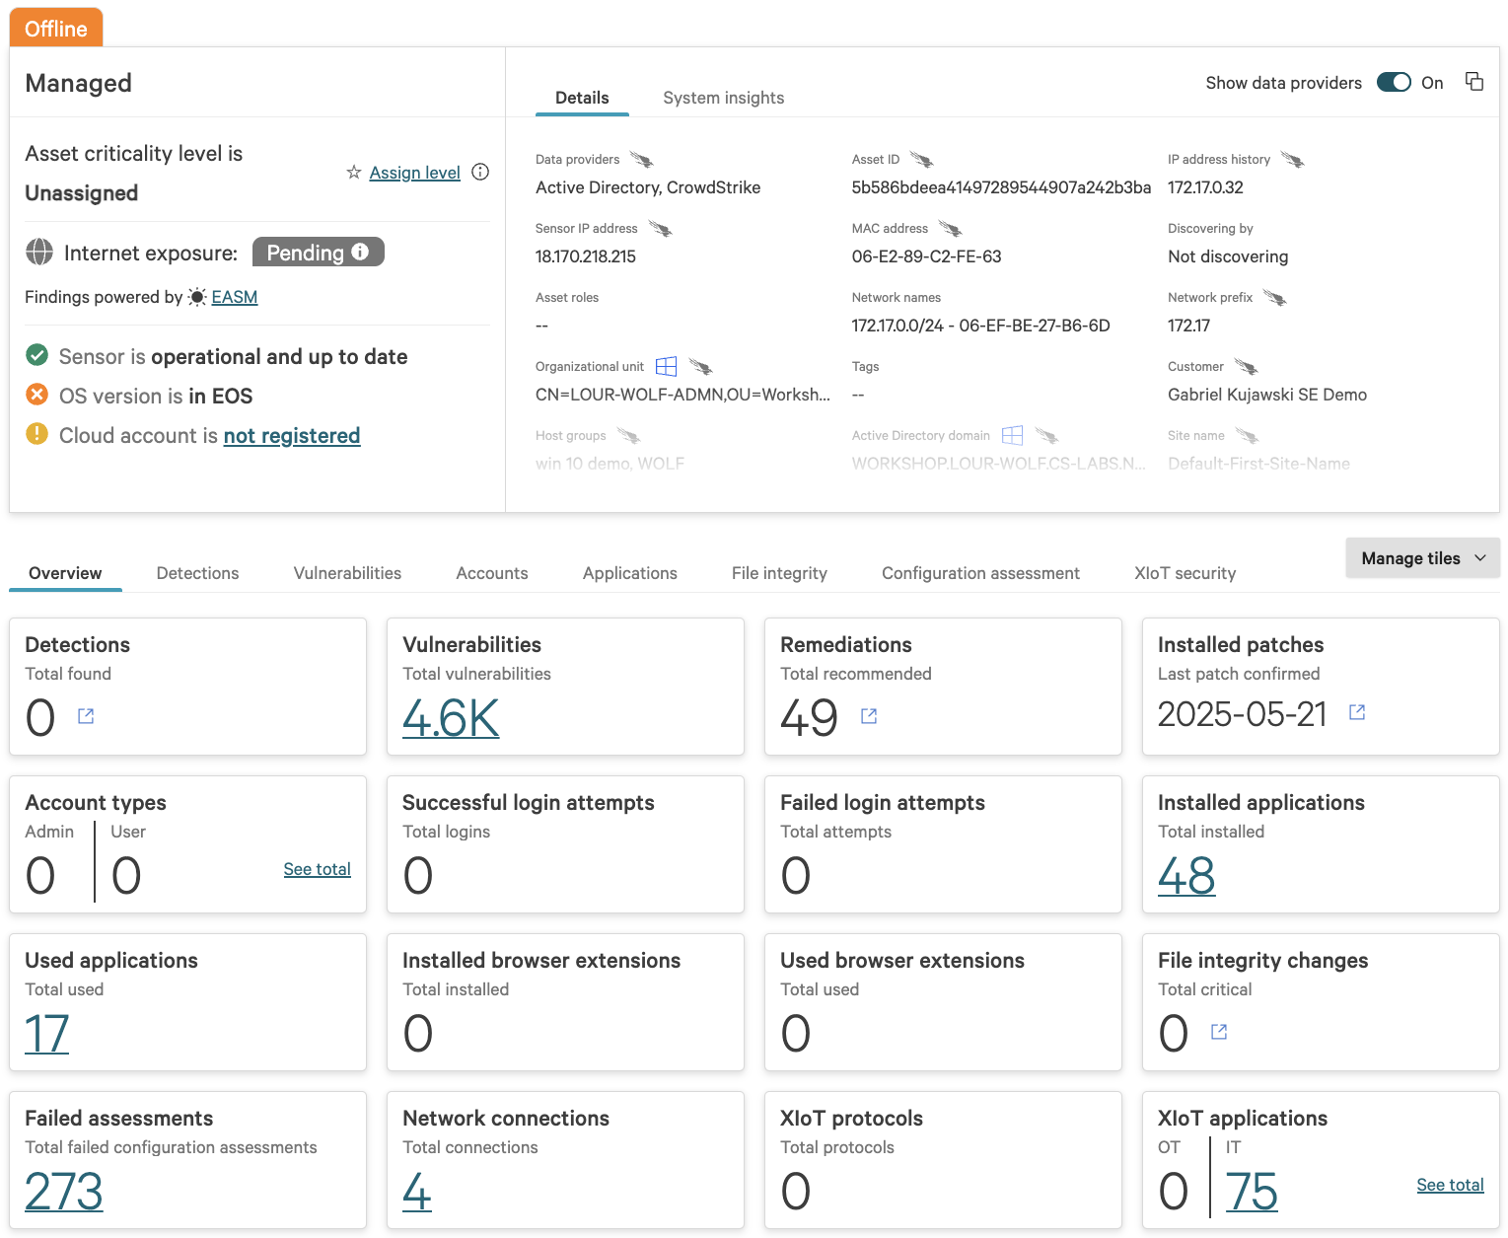

Slide 25
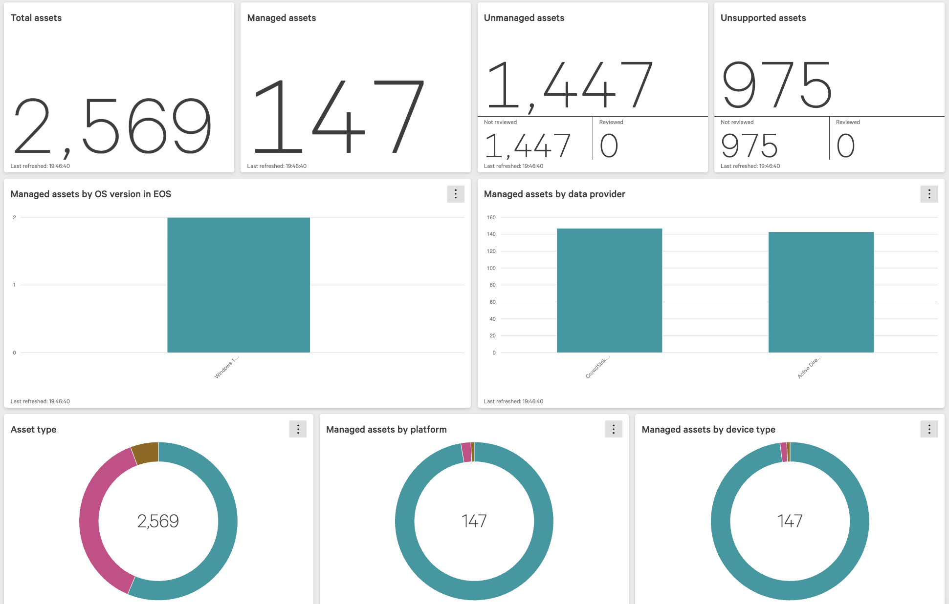

Slide 26
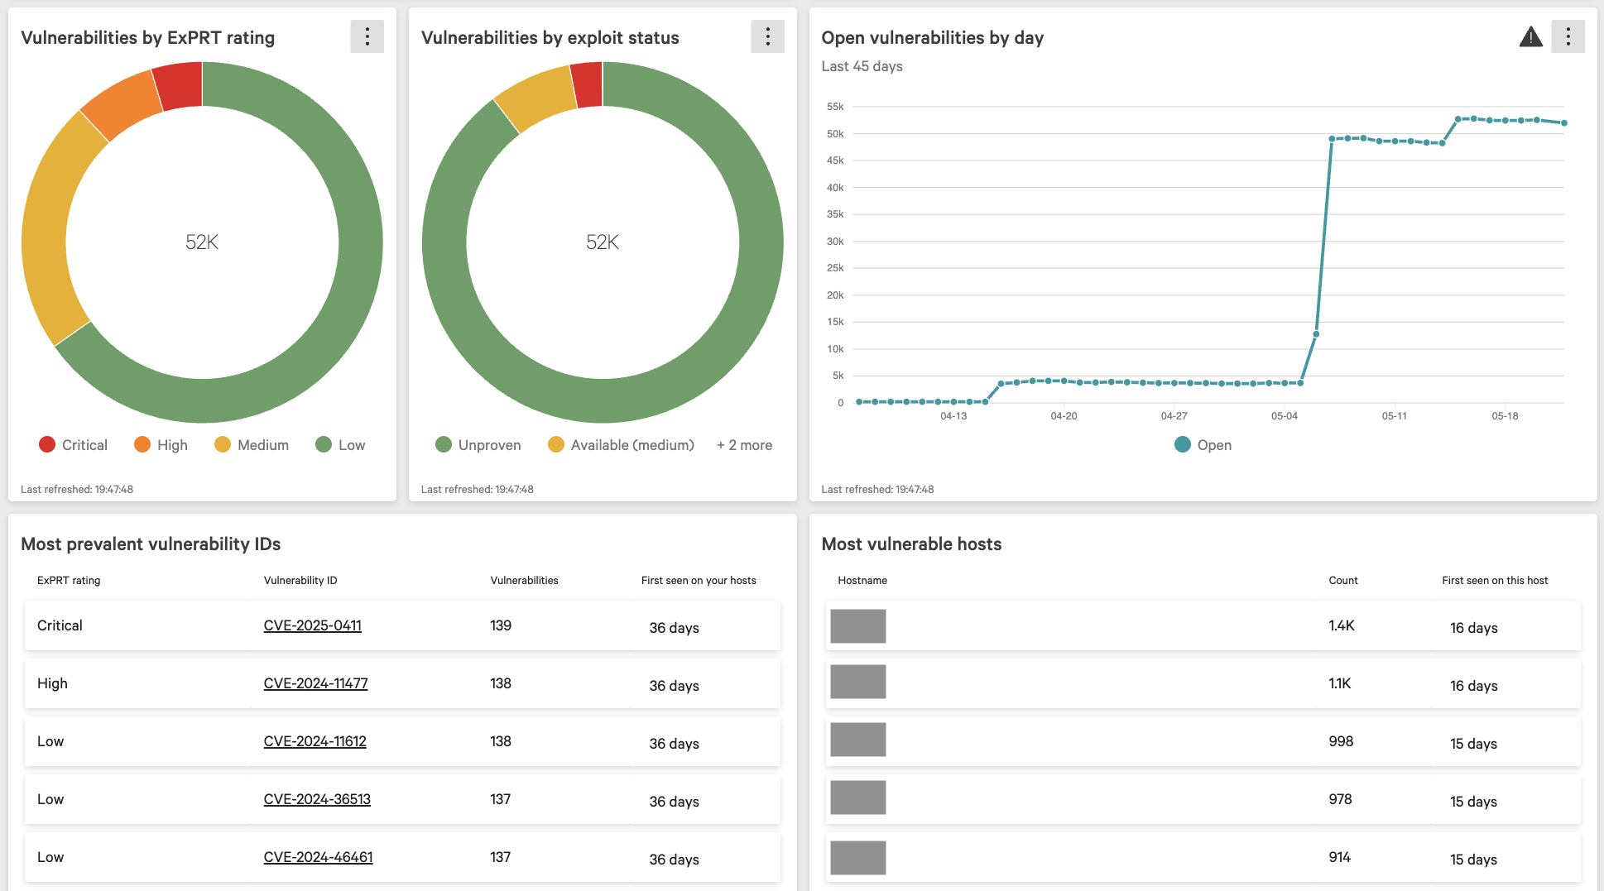
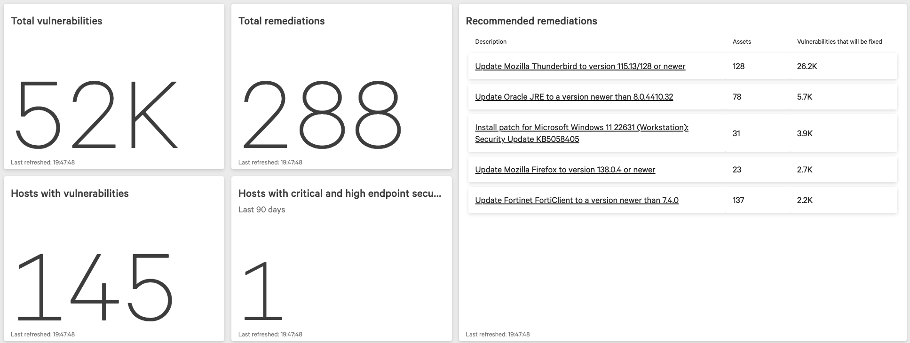

Slide 27
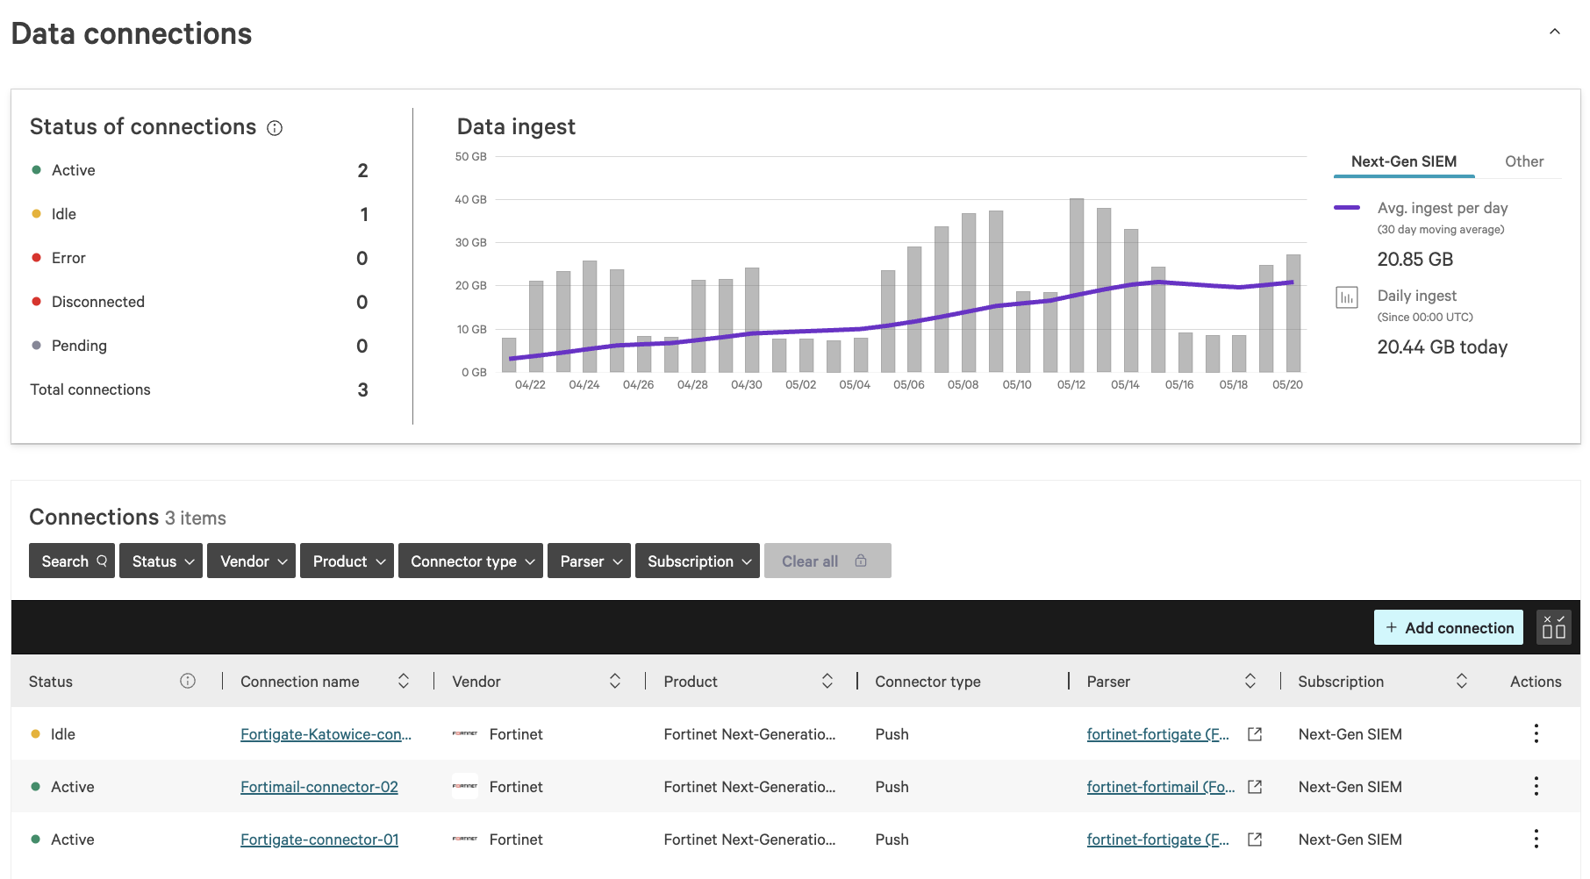

Slide 28
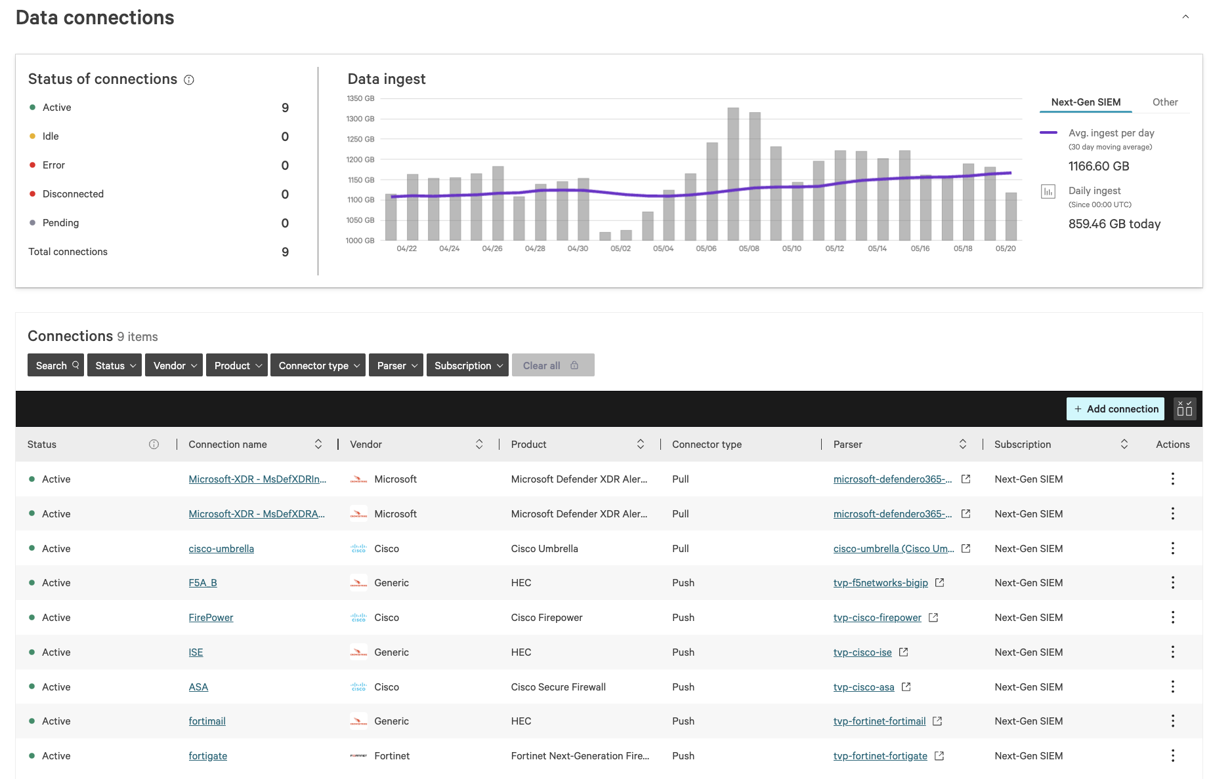

Slide 29
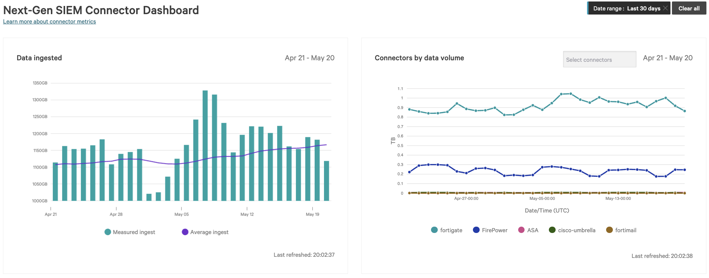

Slide 30
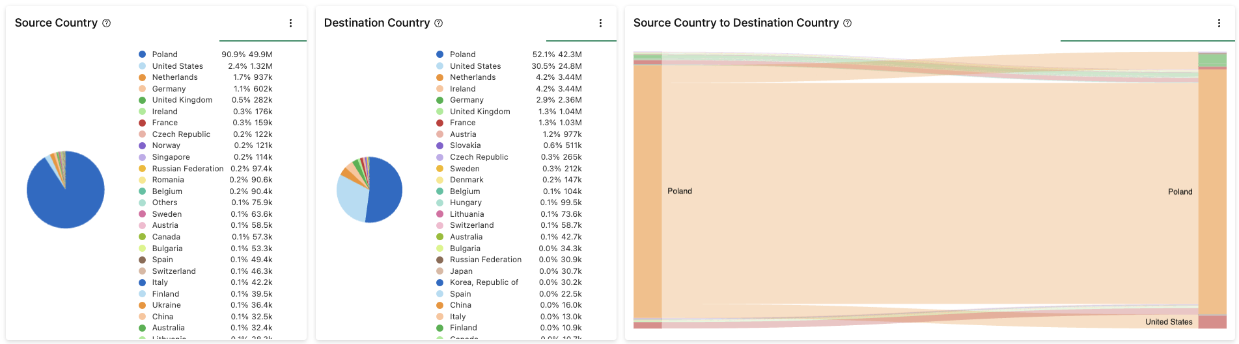
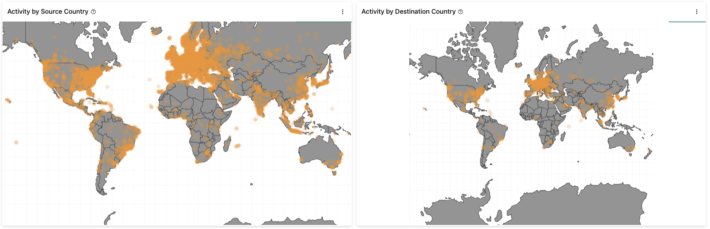
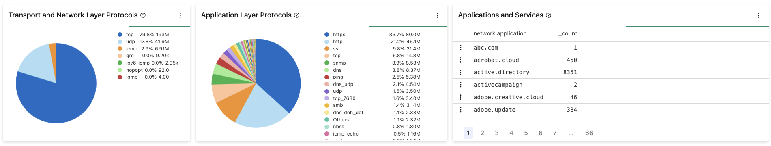
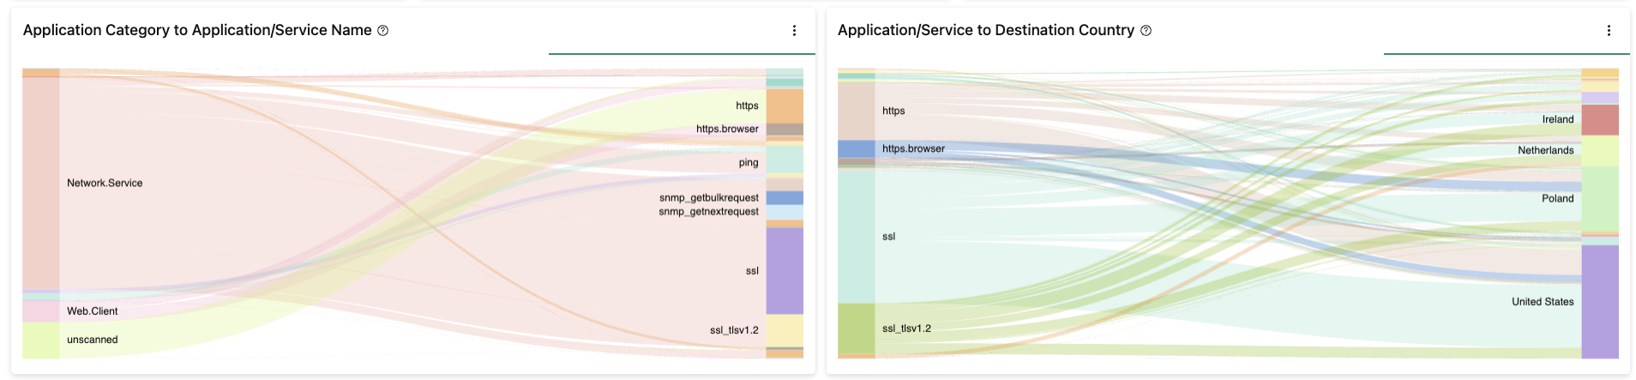

Slide 31
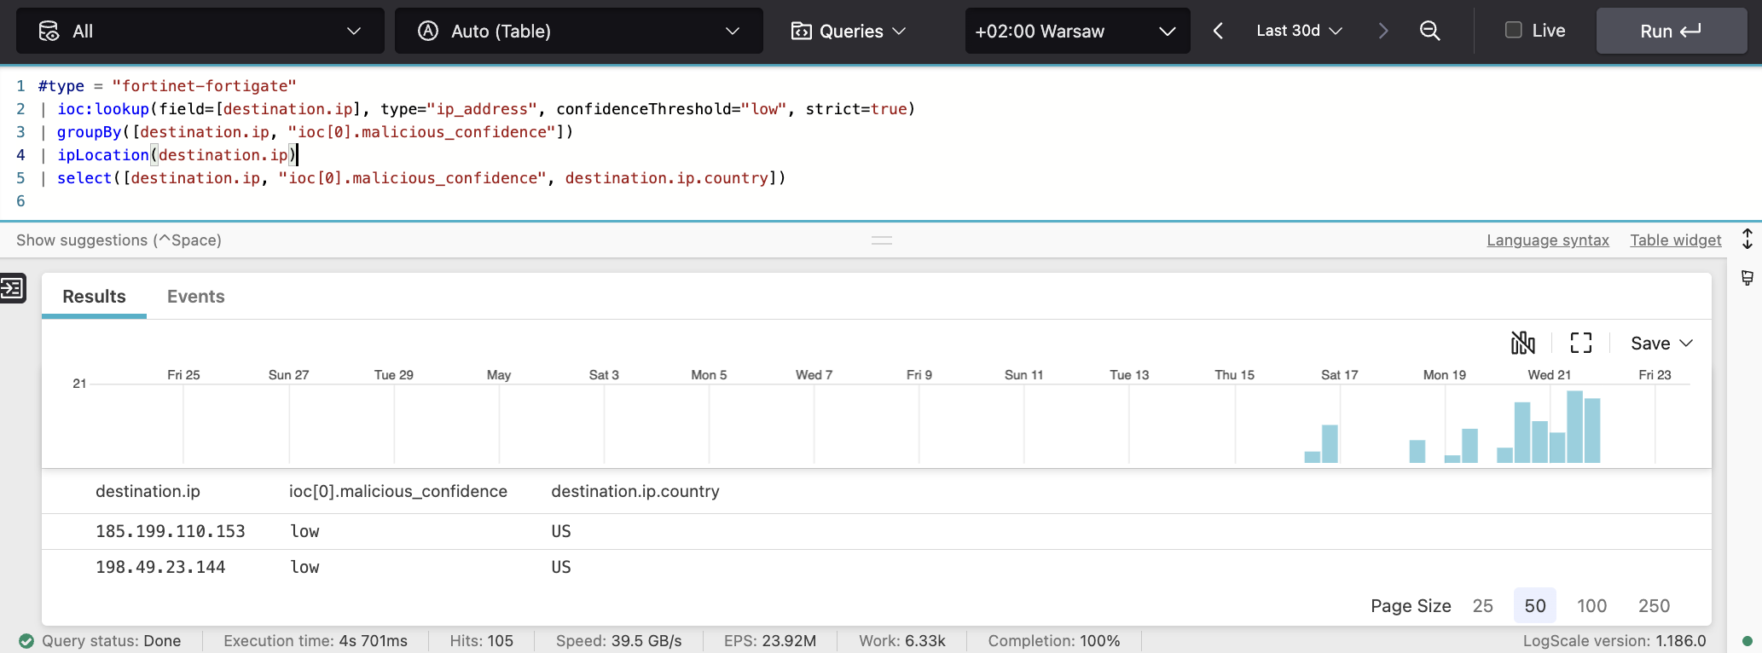
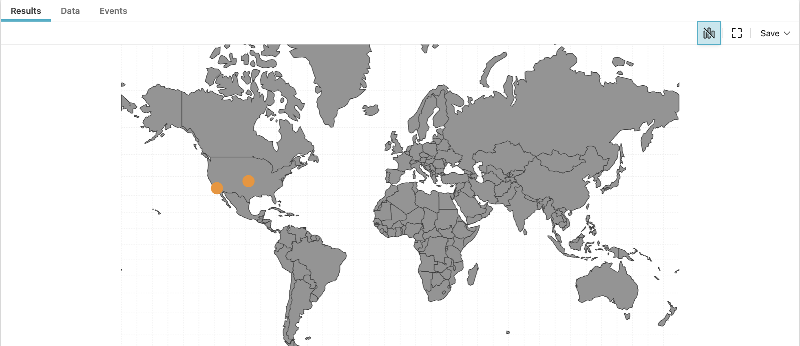

Slide 32
Dziękuję za uwagę!

