Slide 1
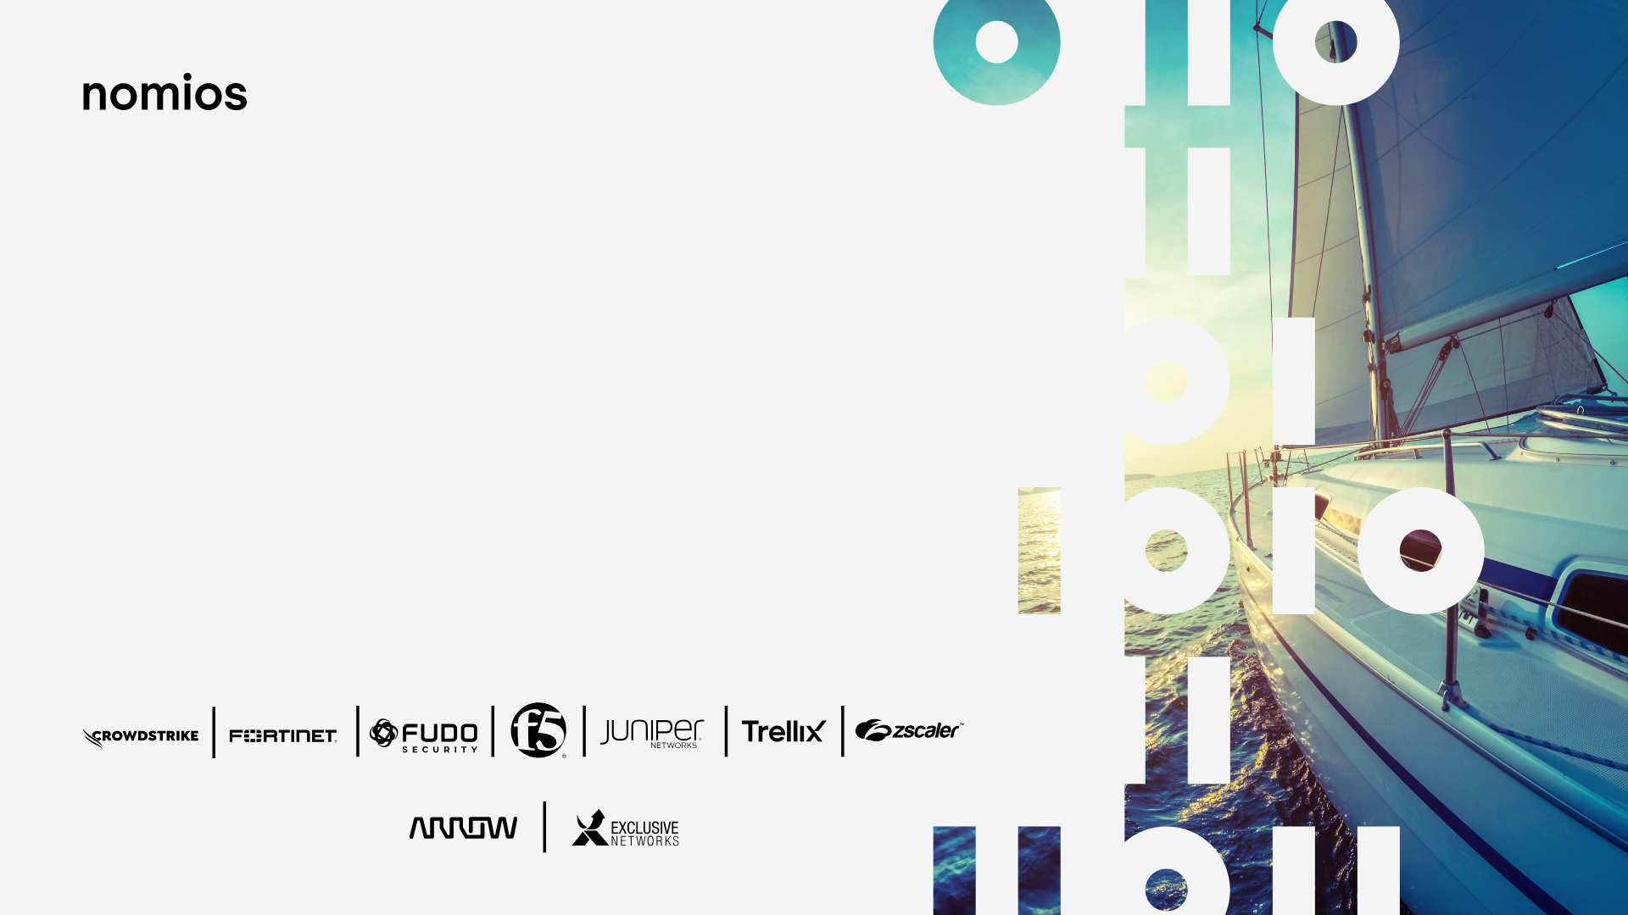
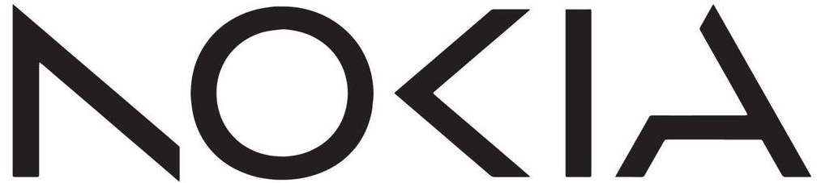
Na nieznanych wodach: Bezpieczny transport danych w erze AI
Rafał Sobiczewski, Nokia
<rafal.Sobiczewski@nokia.com

Slide 2


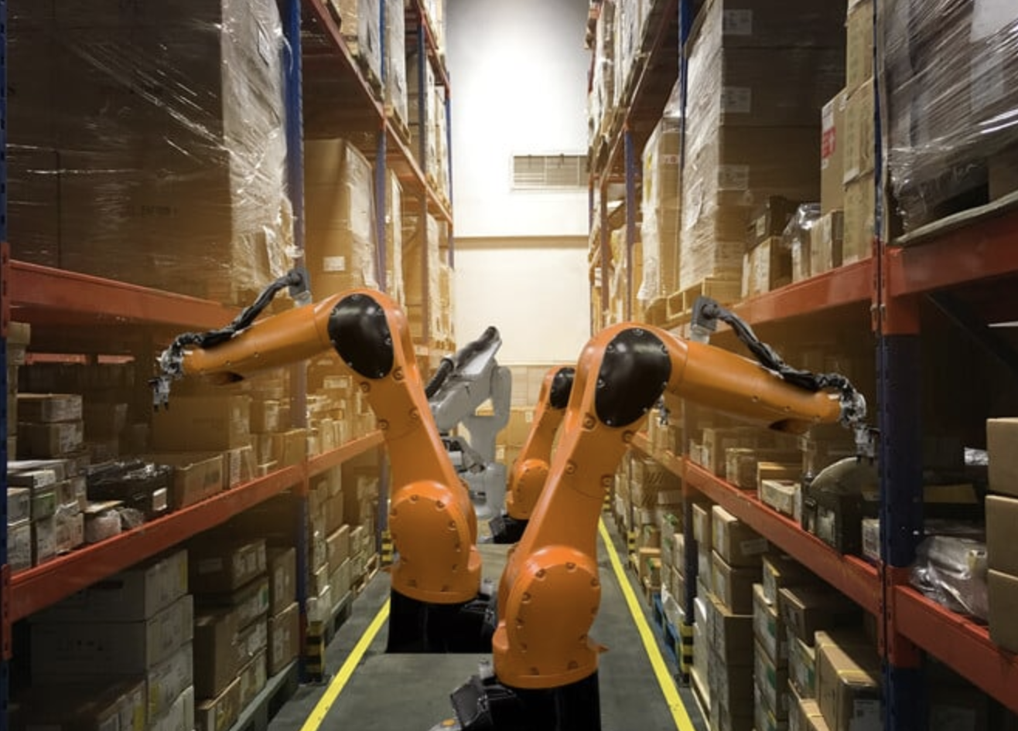
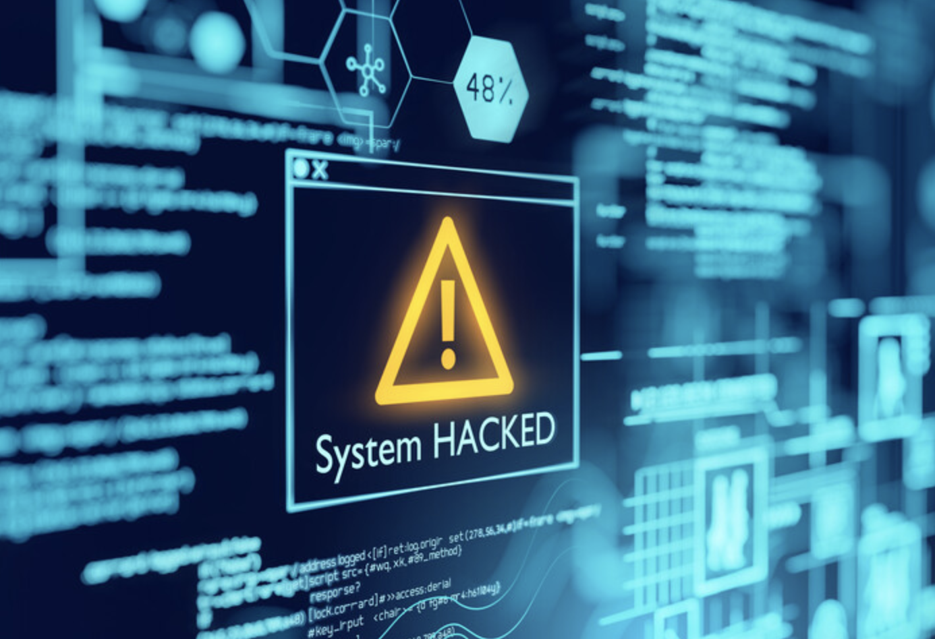

Critical network challenges
2
© 2025 Nokia

Slide 3
24%
Bandwidth
Global WAN AI traffic CAGR
AI accelerating bandwidth growth

Slide 4
27%
Data center
Data Center Capacity CAGR
Power constraint fueling growth in new DC builds
4
© 2025 Nokia

Slide 5
80%
Automation
Downtime caused by human errors
Driving human error to zero and enabling NaaS
5
© 2025 Nokia

Slide 6
166%
Security
DDoS traffic growth 23-24
Growing digital economy is also opening the door to new security threats
6
© 2025 Nokia

Slide 7

Hyper-digital connected world brings large tech investments
The critical role of the network
IT workloads
connectivity
The network provides the dynamic connectivity while meeting the requirements for performance, security and cost
AI-RAN workloads
connectivity
Data center
interconnect
End user
connection

Slide 8

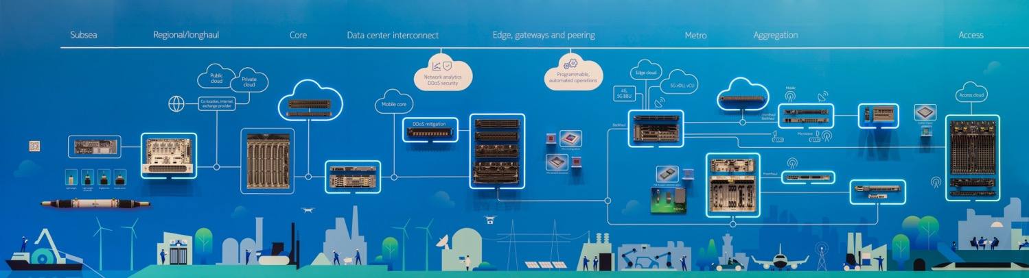
Network the cloud with Nokia
Reliable, secure and automated networks
Fixed Networks ​
Fixed network services and solutions spanning copper, fiber and 5G fixed wireless applications
IP Networks ​
IP and DC networks and services for residential, mobile, enterprise and cloud interconnect applications
Optical Networks ​
Optical transport networks for metro-access, regional, long-haul and ultra long-haul applications
Nokia ranked number 1 sustainable company among 55 companies in the communications equipment industry 2025

Slide 9



Monetize built-in security
Nokia’s multi-layer embedded approach to network security
AI/ML DDoS detection
Nokia AnySec
faster, greener, more accurate;
high-capacity best scaling DDoS filtering for FP silicon
Quantum safe transport at optical and/or IP layer

Slide 10



DDoS attacks have changed…the defense needs to change, too!
The Technical challenge: From spoofed traffic to AI
2000-2020
2020-2024
2024+
Threat landscape:
Spoofed and amplification-reflection
Small number of compromised machines generating spoofed IP traffic abusing misconfigured servers.
Botnet
Thousands of compromised IoT botnet devices flooding links or sending realistic requests to servers.
DDoS booter services offering cheap DDoS.
Botnet + AI
Millions of residential proxies and compromised IoT sending realistic HTTP/DNS/VoIP requests to servers.
Made worse by Multi-gigabit rollouts
Defense
Traffic level monitoring (thresholds, peacetime baselines vs. anomalies); using legacy scrubbers.
Difficult to mitigate using traditional appliances; needs better
detection with internet-wide security context.
Needs fast and accurate AI-driven detection and mitigation to defend against high automation and attack variability, both microburst and long-lived.

Slide 11







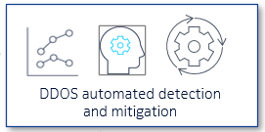





The need for multi-layer security!!
Cloud DDoS protection
Cloud-DDoS Service
when DDoS Attack size > free peering BW
Cloud scrubber (overload)
BGP
API
Syslog
…
Edge/onnet DDoS protection
Edge-mitigation
Protect the entire network and all your services /customers against all Volume and large session attacks on scalable Nokia/Juniper Edge routers
Peering,
Cloud interconnect
Edge-based Protection
Netconf
Flowspec
RTBH
BNG
Netflow/SPM
Defender Mitigation System
or other scrubbing appliance
When edge routers not fit for surgical DDoS filtering or for Premium business customers (or when security teams want their own thing)
Nokia DMS
Netconf
Inline FW/IDS/IPS require also protection against DDoS!!
API/BGP
Deepfield
Existing 3rd party scrubber
IP/MPLS
Inline Next-Gen FW or WAF
Protection DNS & critical servers against application attacks
Controlling access to DMZ/networks & servers
DNS
Critical servers
Inline server/ app/network protection
Business services
Business customer
SPM: Sampled Port Mirorring

Slide 12




Deepfield Defender for fast dependable protection against all DDoS
Highly scalable on-prem solution
Monitors all traffic entering your network
  Netflow-based, or streaming traffic samples for faster detection.
Secure Genome provides AI powered DDoS Detection
  Fast DDoS detection working out of the box with much less false positives & negatives then threshold-based solutions.
AI powered orchestration of DDoS mitigation
  Edge mitigation: activating Nokia router surgical filtering power.
  Or using Nokia DMS scrubbing appliance.
Deep insights into the DDoS and legitimate traffic
  For analytics and forensic investigation.
4
Deepfield Secure
& Cloud Genome®
(on-prem)
Deepfield Defender
Security context
Automated DDoS detection & mitigation orchestration
+ Analytics
2
3
NetFlow SPM*
NETCONF
/FlowSpec
DDoS samples
+
Crawling & scanning
1
IP network
Nokia DMS
(*) SPM = “Sampled Port Mirror”
= Streaming traffic samples for faster and more detailed DDoS detection

Slide 13
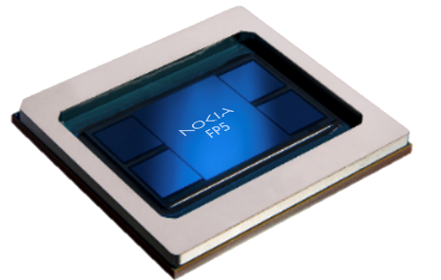
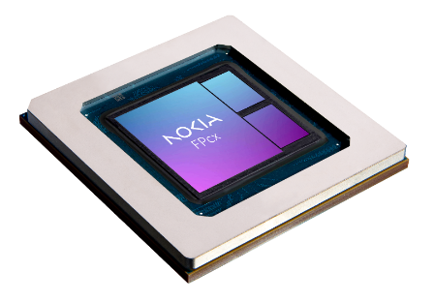
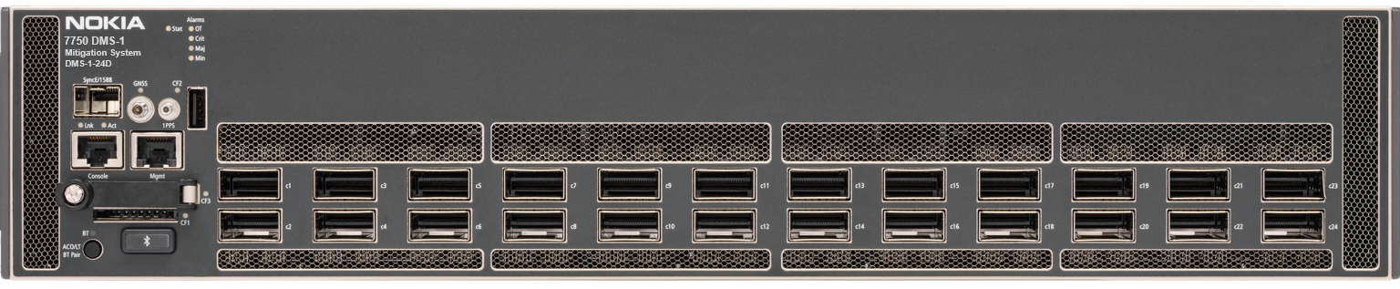
Deepfield unlocks the high-scale DDoS filtering capabilities built-in in Nokia FP Silicon
Nokia Service Routers – Peering/Core/Edge/Aggregation/Datacenter
Large filter-scale: 256K filter-entries (L2/L3/L4 + protocol signatures)
Predictable terabit-scale performance: surgical filtering, without impacting Router-scaling and performance
Fast programming of filters
FP4/FP5 processor
…or FPcx processor
Deepfield Defender Mitigation System (DMS)
Purpose-built DDoS mitigation appliance for offramp scrubbing
Powered by Nokia FP5 + Advanced Countermeasures Engine
Up to 2.8 Tbps mitigation capacity
7750 DMS-1-24D

Slide 14

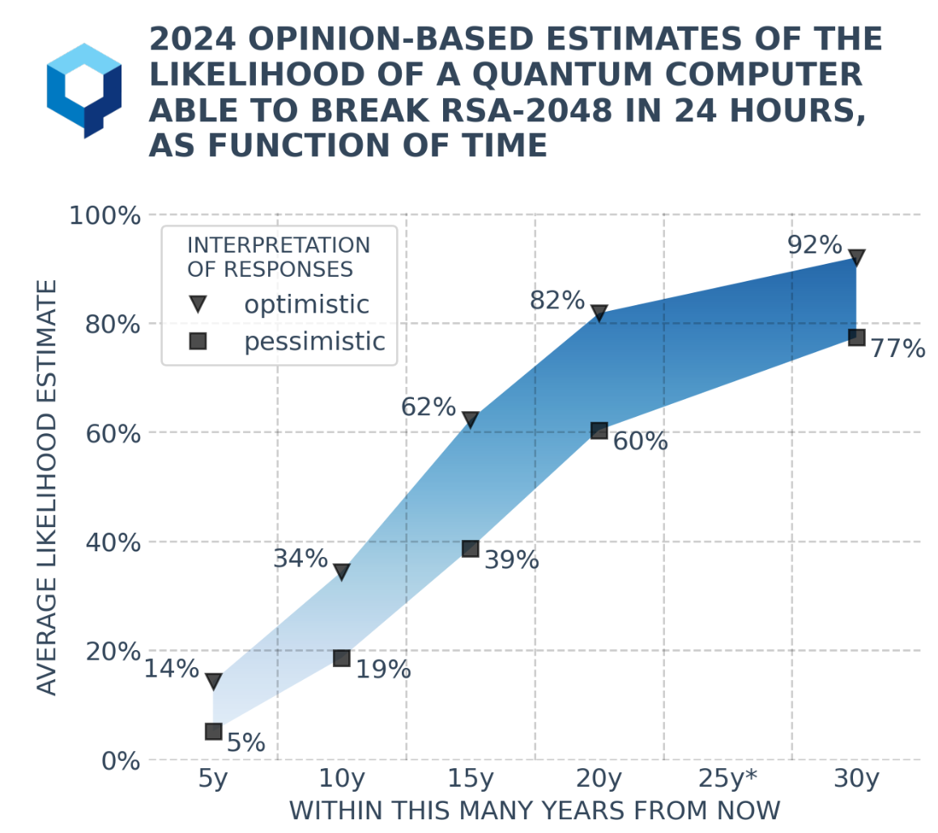

Quantum computing could be ready for prime time within 3 to 5 Years.
“
“
- Bill Gates in the Motley Fool– Feb 13, 2025
Source:

Slide 15



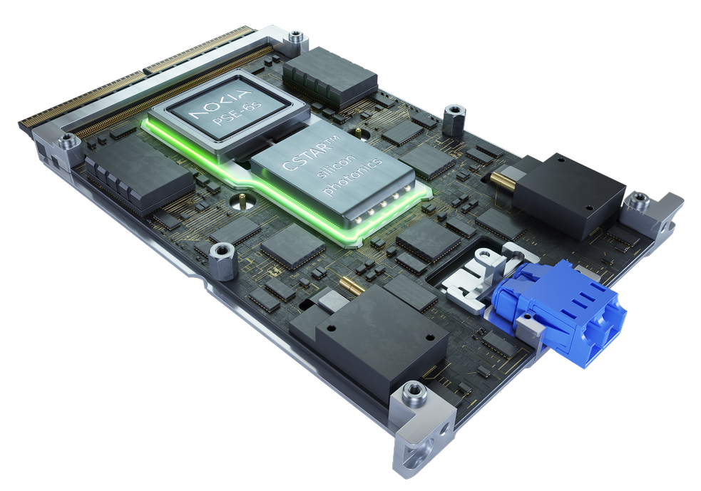
Nokia quantum-safe networks
Delivers defense-in-depth quantum-safe IP solutions today
Adapt
to your
business needs
Physics
(PSK and QKD)
Mathematics
(PKI/PQC)
Quantum-safe keys
Scale
your Quantum-Safe deployment
Application encryption
IP layer (ANYsec/IPsec)
MPLS layer (ANYsec)
Evolve
with the Quantum landscape
Ethernet layer (MACsec)
Optical
IP
Physical layer (OTNsec)
Quantum-safe encryption
Nokia internal use

Slide 16





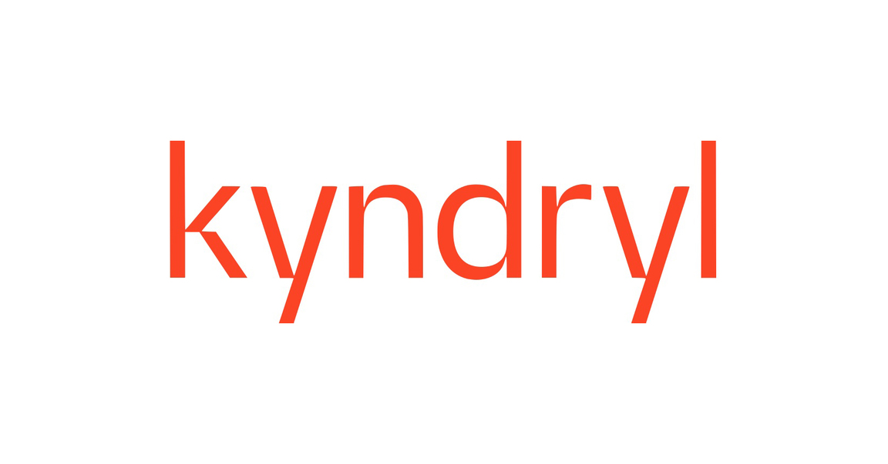
Quantum-Safe Networks in action
IP Telecom
Network includes multiple 100 Gbps and 200 Gbps wavelengths across Portugal, protected with encryption and secure against quantum attack
Press Release:: Nokia partners with IP Telecom to deliver quantum-safe data center connectivity
Proximus
Nokia and Proximus completed the first demonstration of hybrid QKD in a live network,
Press Release: Nokia and Proximus demonstrate future of network security with Europe’s first live hybrid quantum encryption key trial
SK Broadband
Quantum-Safe IP and optical solutions enable KHNP to benefit from uncompromised security, performance and data connectivity for Korea Hydro and Nuclear Power.
Press Release: Nokia and SK Broadband deploy quantum-secure network to protect Korea Hydro and Nuclear Power IT infrastructure
Partnership with Kyndryl
Nokia and Kyndryl helped a major financial services customer deploy quantum-safe data center interconnect networks
Press Release: Why businesses need quantum-safe networks now
GRNet
GRNet’s HellasQCI consortium demonstrated a quantum-safe network spanning Greece.
Uses both classic and quantum physics key generation, orchestrated by 1830 SMS, to help HellasQCI secure critical infrastructure.
Press release: Hellas QCI and Nokia lead way to the future of Quantum-Safe-Networks
SPTel, ST Engineering and Fortinet
Enhancement to Singapore’s National Quantum Safe network, leveraging quantum-safe optical transport.
Press release: SPTel Partners with ST Engineering, Nokia and Fortinet on Quantum-Safe Services to Boost Cyber Defence for Organisations

Slide 17







Network the cloud with Nokia
Moving beyond pure connectivity
Nokia helps you build networks that sense, think and act to enable value-added, personalized services
Differentiated services
Insight
Security
Performance
Quantum-safe, DDoS mitigation
Network capable of monitoring, processing, and acting on the vast amounts of data it carries
Subscriber and service-aware
Attributes
Deterministic quality of service
Programmable network

Slide 18
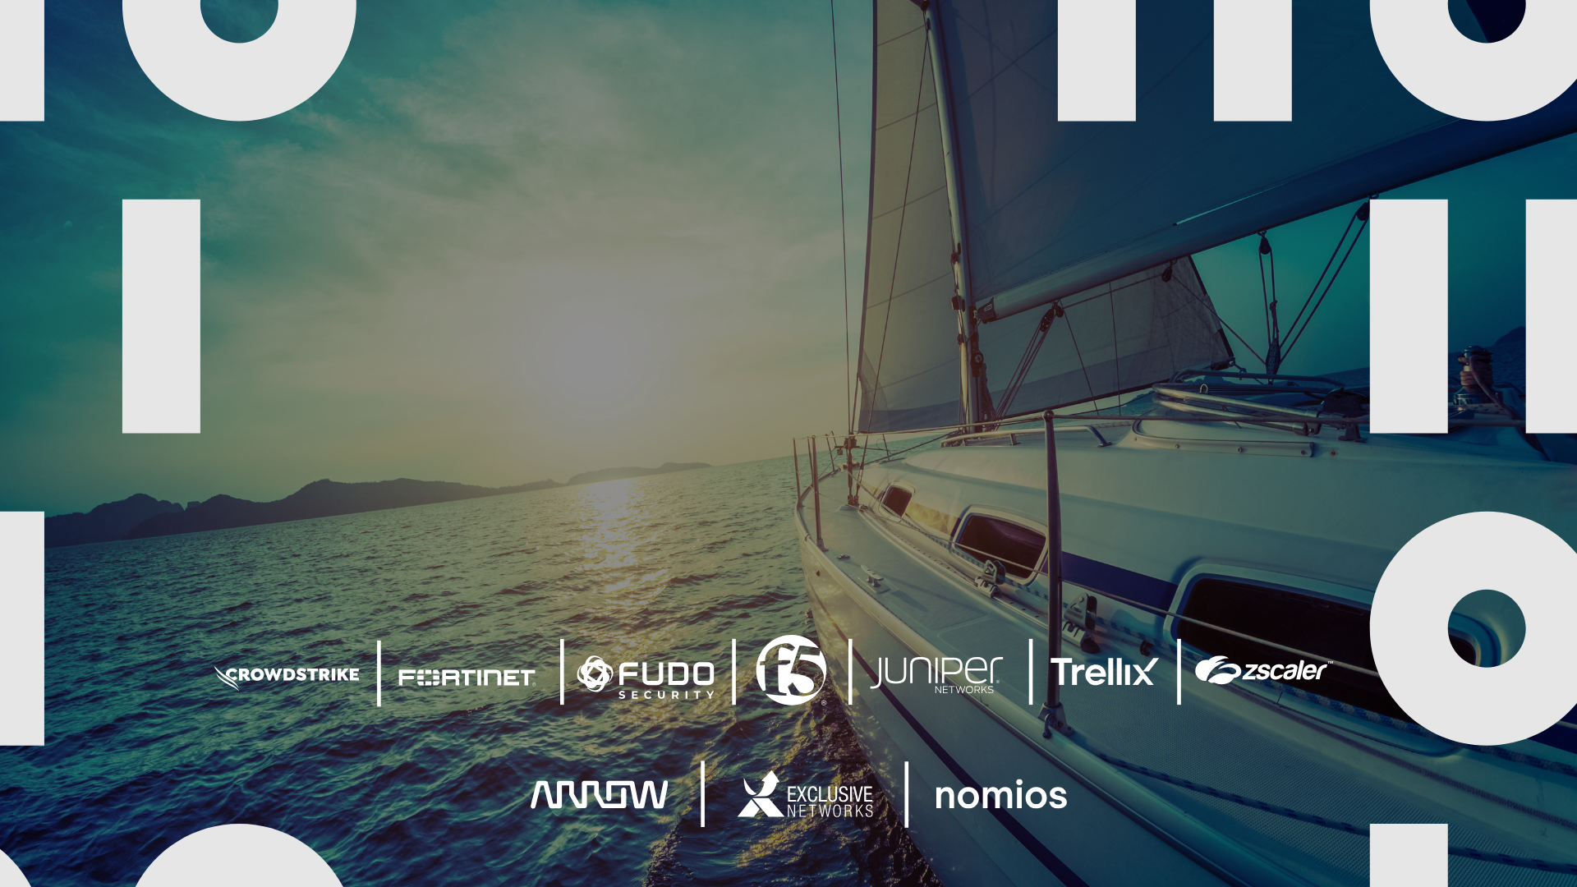
Dziękuję za uwagę!

