Slide 1
Juniper AI-Native Campus & Branch
Kamil Kułak
Territory Account Manager
kkulak@juniper.net

Slide 2


























AT A GLANCE
FOUNDED
HEADQUARTERED
2022 REVENUE
1996
Sunnyvale, CA
$5.30B
GLOBAL REACH | 10,400 EMPLOYEES | + | 120 LOCATIONS | + | 50 COUNTRIES | + | 24/7 AVAILABILITY TO ADDRESS ALL CUSTOMER NEEDS
OUR MISSION: Power connections. Empower change. | OUR VISION: Driven by Experience
WE
SUPPORT
10 out of
Forbes 10
30 of the 30
40 out of 40
17 of the 20
18 out of 20
8 out of 10
8 of the 10
WORLD’S
TOP CLOUD
OPERATORS
TOP GLOBAL
SERVICE
PROVIDERS
MOST PROMINENT
UNIVERSITIES
GLOBALLY
LARGEST
GLOBAL
BANKS
TOP
TECHNOLOGY
COMPANIES
TOP
GLOBAL
RETAILERS
COMPANIES
GLOBALLY
All stats based on global industry lists, with material (>$10K) Juniper SA from 2022.
OUR STRATEGY | Experience-first Network
OUR STRATEGY | Automated WAN Solutions | Cloud-ready Data Center | AI-Native Campus & Branch
 | Connected Security
REACHING THE HIGHEST STANDARDS | ENCOURAGING FUTURE INNOVATORS

Slide 3








Instead of company introduction IN simple terms
Technically What WE DO:
Move packets long distances
Routing
Move packets short distances
Switching
Stop packets
Security
Add intelligence to the above
Software
Content

Slide 4








AI-Native Campus & Branch – client-to-cloud
Marvis
Client
Cloud
Why is my network experience bad ?
Wi-Fi Assurance
Wired Assurance
WAN Assurance
NAC
Wireless LAN
Wired LAN
SD-WAN + Secure Edge

Slide 5

“
“
I paid for Wi-Fi at my hotel, but I still can’t load new emails.
My phone has full bars, but my Zoom call keeps going in and out.
”
”
Connectivity is not the same
as experiencing a great connection
“
“
My internet is down but there are no outages reported.
I’m connected, but my video is pixelated.
”
”

Slide 6



Digital Transformation Starts with the Network
Platform for Digital Innovation
Measure and metric user experience
Customer Engagement
Integrated location services
Integration with 3rd parties like ServiceNow
The Right Architecture for growth and agility
Best
Business Outcomes
Better Network Operations
Fewer Tickets
Faster MTTR
AI Driven Operations, Proactive Support and RCA
Fewest Tickets
Automated, No Mistakes
Zero Touch Provisioning
Fewer templates, more flexibility.
Automated IoT onboarding
Fastest Rollout

Slide 7
Security
Mist Cloud is hosted in AWS Frankfurt for EU customers
Customers with headquarters (or main address provided to Juniper) located in the EU are automatically set up for hosting in an EU data center. This means the Customer’s Device Data and the rest of its Juniper cloud instance will be hosted in the EU. Additionally, Customers may elect EU-based hosting even if their headquarters or main address provided to Juniper are not located in the EU.
https://www.mist.com/wp-content/uploads/Mist_AI_Trust_Tech_Brief_fin.pdf

Slide 8
Demo

Slide 9











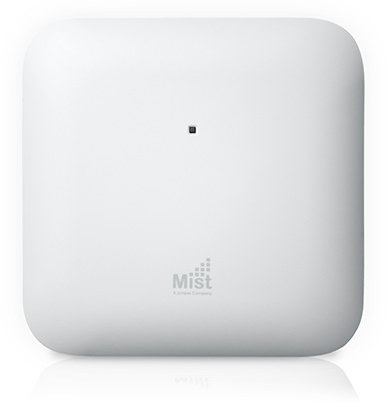
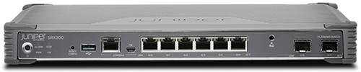
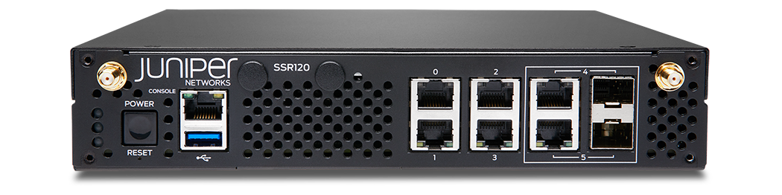

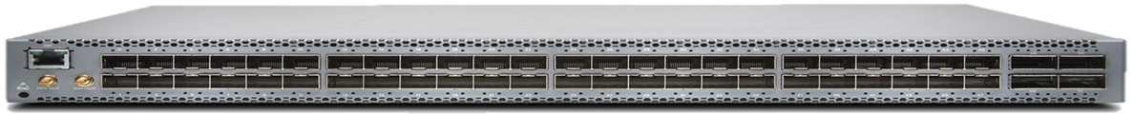
AI-Native Campus & Branch Portfolio
Marvis
AI-driven Problem Solver
Conversational Assistant
Digital Experience Twin
Marvis Actions
Proactive Network Insights & Remediations
All Encompassing Network Visibility
Virtual Network Assistant
Premium
Analytics
AI-Native Cloud Services
IoT
Assurance
Access
Assurance
Wi-Fi
Assurance
User
Engagement
Asset
Tracking
Wired
Assurance
WAN
Assurance
Wireless Infrastructure
Wired Infrastructure
WAN Infrastructure
Improve experiences and revenue with Indoor Location Services
EX Series
QFX Series
SRX Series
SSR Series
Mist Edge
AP Series
BT11 (BLE)

Slide 10
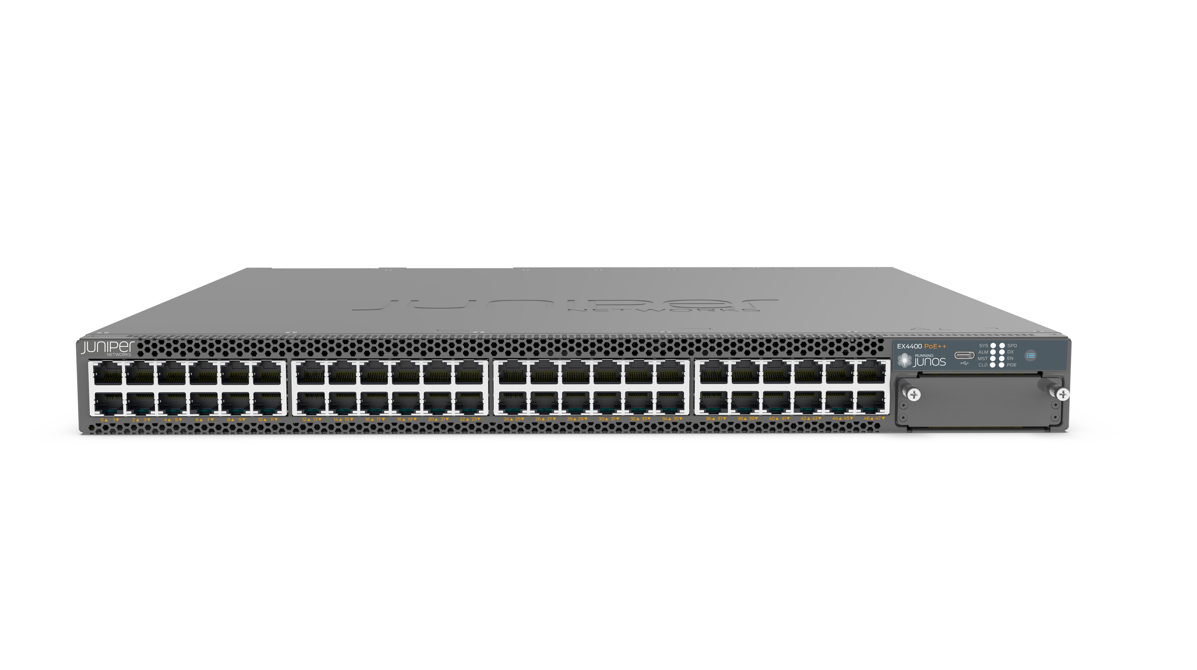
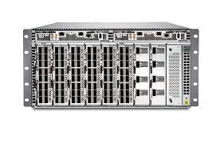
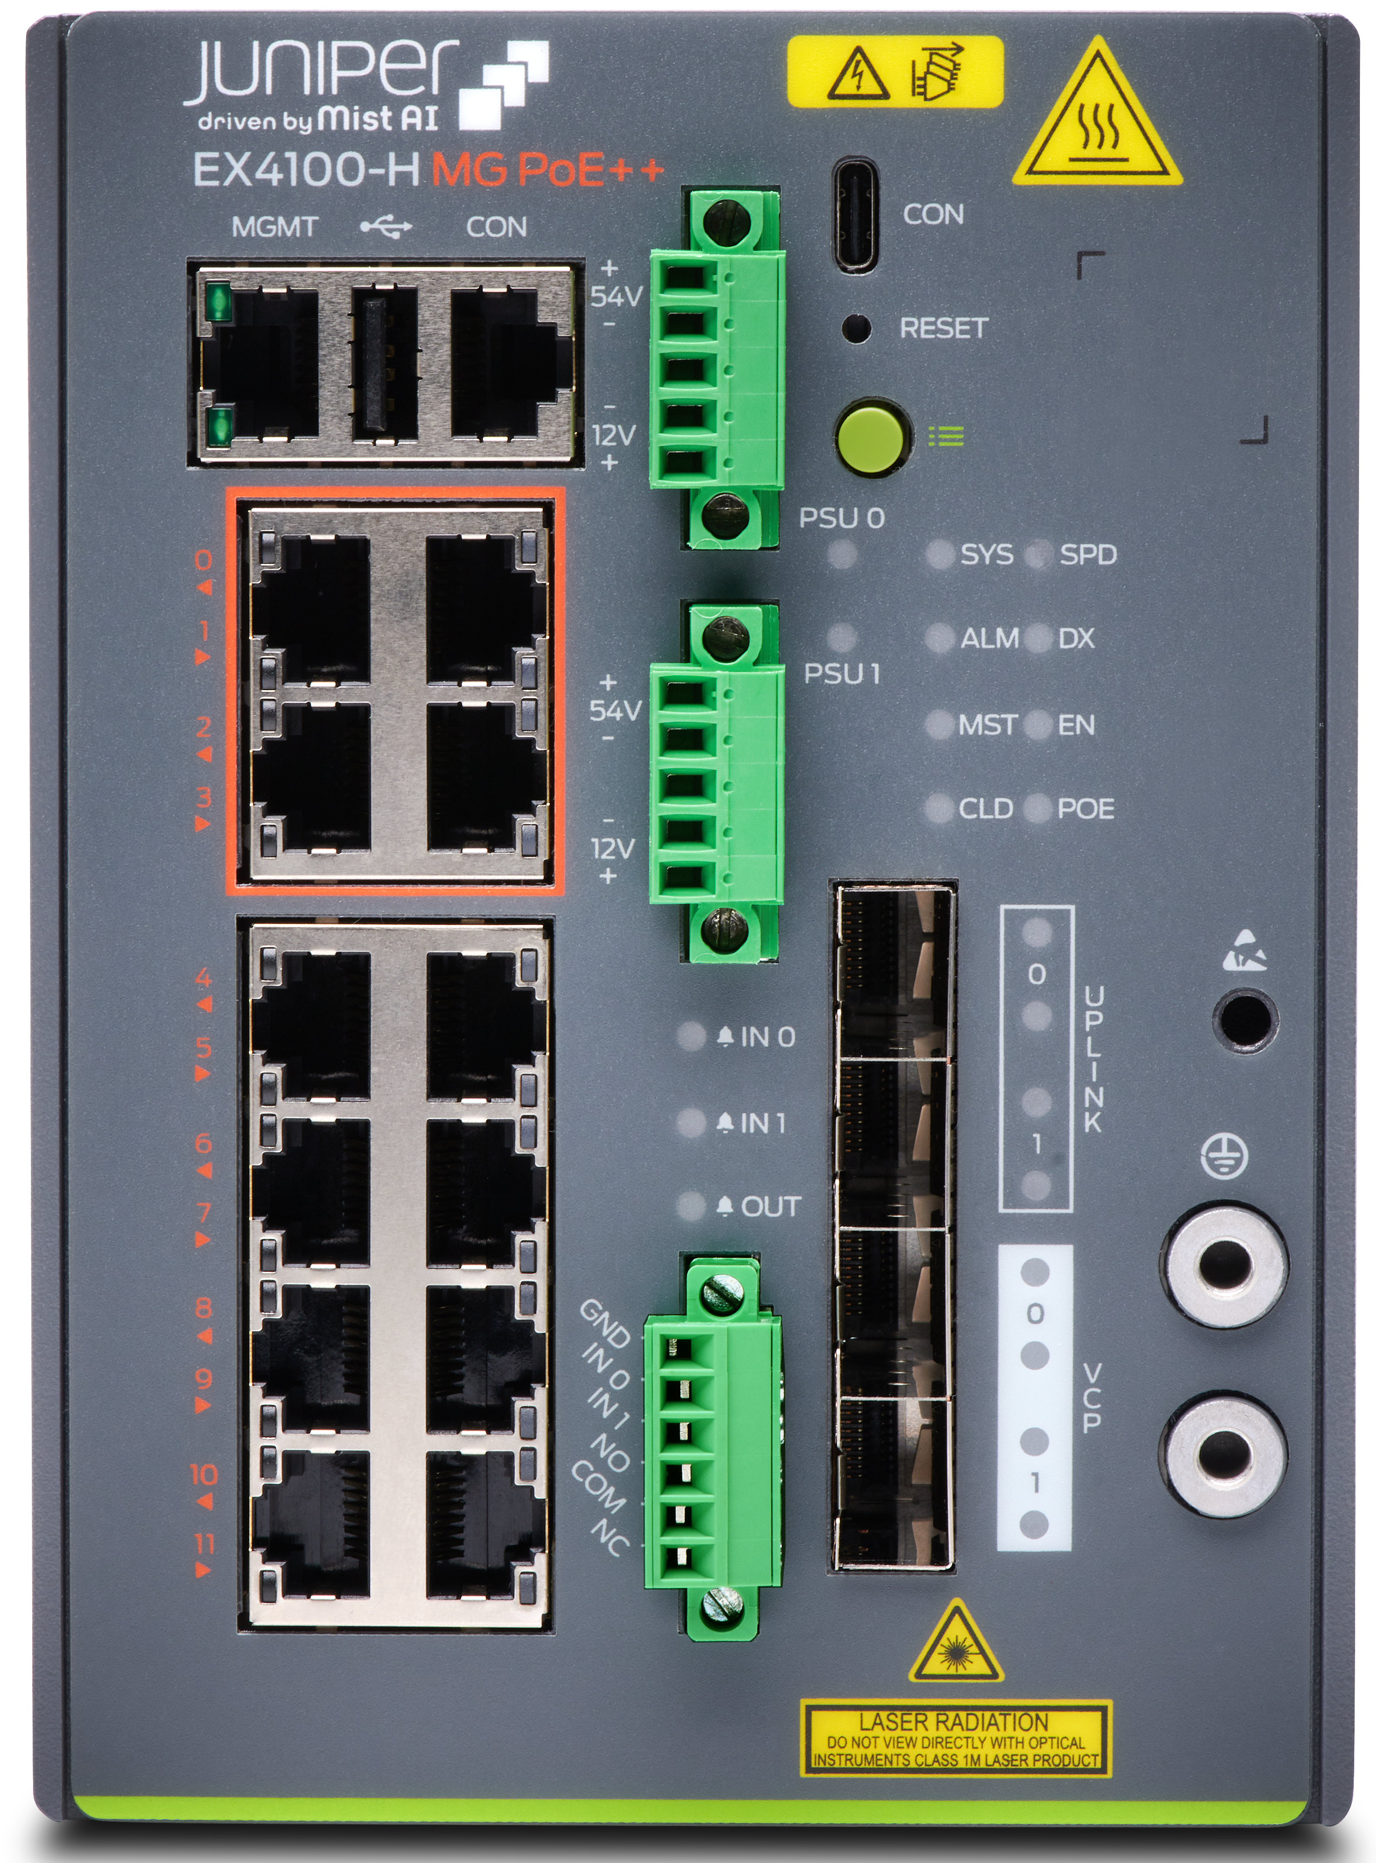





Enterprise Campus Switch Portfolio
Juniper EX/QFX Series Ethernet Switches
New
New
EX4000
EX4400-48XP/MXP
EX4400-24X
EX2300
EX4100-H
EX4100-F
EX3400
EX4100
EX4300-MP
EX4400
EX4600
EX4650
QFX5110
QFX5120
EX9200
QFX5130
QFX5700
Access
Distribution / Core
Cloud-ready, AI-driven switches (Wired Assurance)
1G/Multi-Gig
PoE+, PoE++, Fixed PSU and Fans, Compact, Fanless option, 10G Stacking, 10G Fixed Uplinks
Fixed Power
1G, Multi-Gig
PoE, PoE+
Ruggedized, Multi-Gig, PoE++, EVPN-VXLAN GBP, Flow-Based Telemetry
Fixed Power PoE, PoE+, EVPN-VXLAN GBP, Flow-Based Telemetry
Modular Power
1G: PoE, PoE+
Modular Power
1G, Multi-Gig
PoE, PoE+,
PoE++, EVPN-VXLAN GBP, Flow-Based Telemetry
Modular Power
1G, Multi-Gig
PoE, PoE+,
PoE++, EVPN-VXLAN
Modular Power 1G, Multigigabit PoE, PoE+, PoE++, EVPN-VXLAN GBP, Flow-Based Telemetry
10/40GbE
10/25/100GbE
10/40/100GbE
10/25/100GbE
10GT/100GbE
Modular
1/10/25/40/100/400GbE

Slide 11
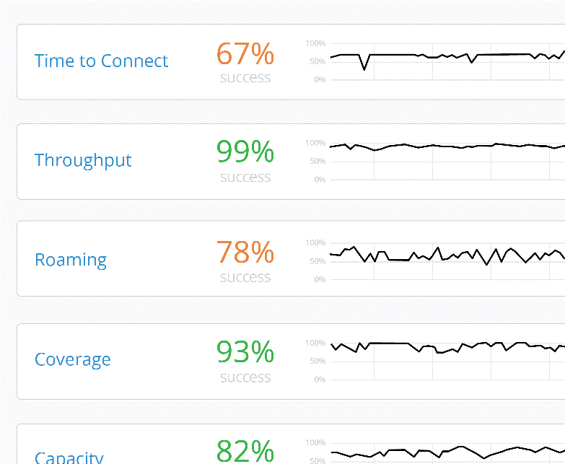










Key Differentiators
YUM CAFE CUSTOMER
Hi Jeff! Welcome back to Yum Cafe.
Your order is ready for pickup
at the counter, see you soon.
Save $2.00
Chicken Fry
Add our signature Chicken Fry sandwich to your order now
$2
Client Level
Visibility
AI-driven Operations and Support
Microservices Cloud for Agility
Digital Engagement with Virtual BLE
Underpinned by a 100% Open API driven architecture
Delivered Across the Full Stack
Notes:
Dlaczego Mist?
1. W sytuacji, kiedy urządzenie łączy się z siecią, może wystąpić cały szereg problemów. Mist śledzi każdego klienta w czasie rzeczywistym i dokładnie rozumie, co się dzieje. I w sposób proaktywny jest w stanie zidentyfikować niezadowolonego użytkownika, zanim on sam zdąży to zgłosić.
2. Następnie informacja ta jest łączona ze sztuczną inteligencją, aby faktycznie zrobić to, co administrator zrobiłby w tej sytuacji, gdyby wiedział, że dany użytkownik ma problem. Możemy przechwytywać pakiety danych; możemy przeprowadzać root cause analysis i dokładnie powiedzieć, co jest nie tak i gdzie w sieci występuje dany problem
3. wyeliminowanie architektury kontrolera i przejście do nowoczesnej chmury mikrousług, pozwala osiągnąć wysoki poziom niezawodności, elastyczności i skalowalności. Rozwiązanie zarówno dla większych, jak i mniejszych firm. Wraz z rosnącymi potrzebami, jesteśmy w stanie odpowiednio się wyskalować. Możemy również bardzo elastycznie odpalać instancje klientom którzy wymagają niszowych ustawień.
Dzięki temu, że jest to rozwiązanie chmurowe, mamy tutaj inny cykl wdrażania nowych funkcji. – co miesiąc, co kilka tyg, dzięki czemu sieć fullstack może rozwijać się z taką samą szybkością, jak urządzenia końcowe, które się do niej podłączają.
4. Są różne serwisy lokalizacyjne, dzięki którym mamy możliwość śledzenia end pointow na mapie, wizualizowania ich i pewnej analityki z tym związanej. Możemy również wchodzić w interakcje z użytkownikami końcowymi za pośrednictwem aplikacji na smartphonie która jest zintegrowana z mist SDK - nawigowanie, albo użytkownik zbliża się do konkretnego miejsca i cos się zadzieje w aplikacji

Slide 12





Analyst Recognition Across Our Portfolio
A LEADER
A VISIONARY
A CHALLENGER
A LEADER
Gartner®
Gartner®
Gartner®
Gartner®
2024 Magic Quadrant™ for
Enterprise Wired & Wireless LAN Infrastructure
2023 Magic Quadrant™ for
SD-WAN
2022 Magic Quadrant™ for
Network Firewalls
2024 Magic Quadrant™ for
Indoor Location Services, Global
Gartner Magic Quadrant for Enterprise Wired and Wireless LAN Infrastructure, Mike Toussaint, Christian Canales, Neuman Raja, Mike Leibovitz 6 March 2024.
Gartner Magic Quadrant for SD-WAN, Jonathan Forest, Andrew Lerner, Naresh Singh, Karen Brown, 27 September 2023.
Gartner Magic Quadrant for Network Firewalls, by Rajpreet Kaur, Adam Hils, Thomas Lintemuth, 19 December 2022.
Gartner Magic Quadrant for Indoor Location Services, Tim Zimmerman, Annette Zimmermann, 28 February 2024.
GARTNER and Magic Quadrant are registered trademarks and service mark of Gartner, Inc. and/or its affiliates in the U.S. and internationally and are used herein with permission. All rights reserved.
Gartner does not endorse any vendor, product or service depicted in its research publications, and does not advise technology users to select only those vendors with the highest ratings or other designation. Gartner research publications consist of the opinions of Gartner’s research organization and should not be construed as statements of fact. Gartner disclaims all warranties, expressed or implied, with respect to this research, including any warranties of merchantability or fitness for a particular purpose.
This graphic was published by Gartner, Inc. as part of a larger research document and should be evaluated in the context of the entire document. The Gartner document is available upon request from Juniper Networks.
Notes:
For the third year in a row Juniper is named a Leader in the 2024 Gartner® Magic Quadrant™ for Indoor Location Services.
For the fourth year in a row Juniper is named a Leader in the 2024 Gartner® Magic Quadrant™ for Enterprise Wired and Wireless LAN Infrastructure.

Slide 13
kkulak@juniper.net

